Slide 1
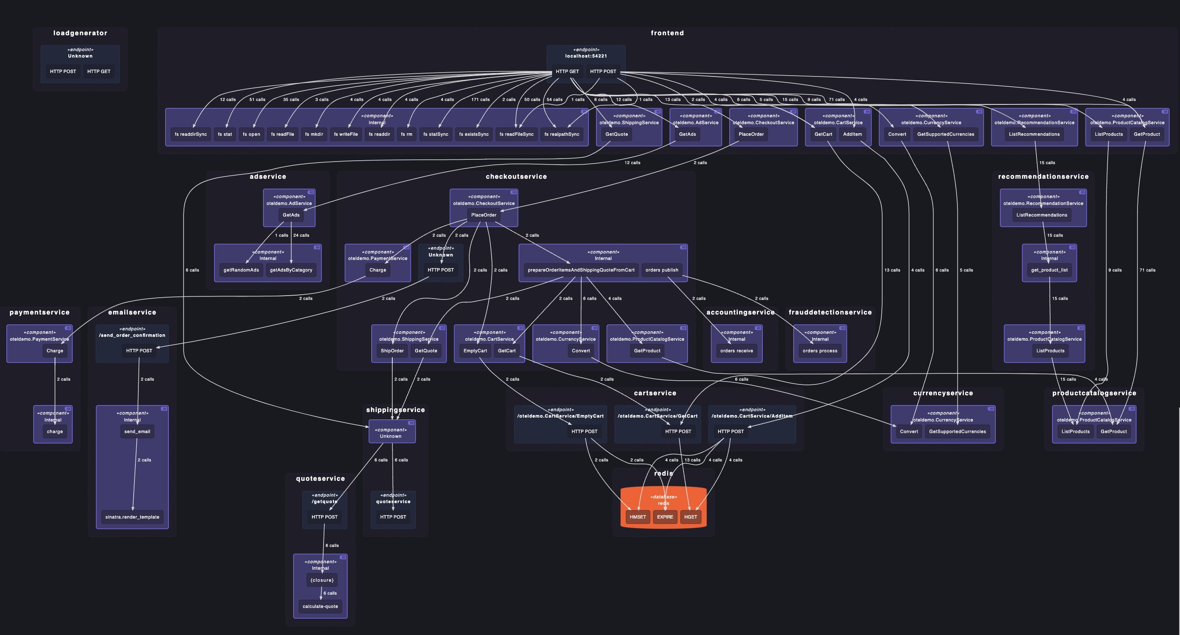
OpenTelemetry
Making sense of distributed systems

Slide 2
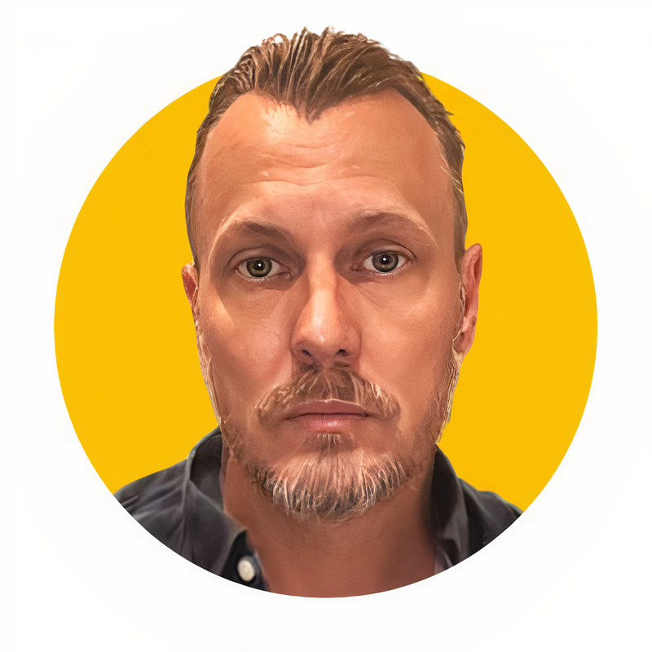
Roger Johansson
Creator of:
Proto.Actor
Akka .NET
TraceLens
Company: Asynkron
Twitter: @rogeralsing
Github: rogeralsing
Mail: roger@asynkron.se

Slide 3
What is OpenTelemetry?
OpenTelemetry is a set of APIs, SDKs, tooling, and integrations designed to capture and export telemetry data (metrics, logs, and traces) for observability. It standardizes how data is collected and transferred, facilitating application monitoring and troubleshooting.

Slide 4
History of observability
Logs
Logs with correlation ID
3rd party tooling DynaTrace, DataDog, ApplicationInsights
Zipkin, Jaeger, OpenTracing, OpenCensus
One unified model - OpenTelemetry

Slide 5
Use cases for observability?
Health monitoring
Performance monitoring
Diagnostics / Debugging, understanding data flows
Operations stole observability, let´s take it back

Slide 6
The three pillars of observability
Logs
Traces
Metrics
Profiler data. …so, four pillars?

Slide 7
Real-world distributed system debugging?

Slide 8

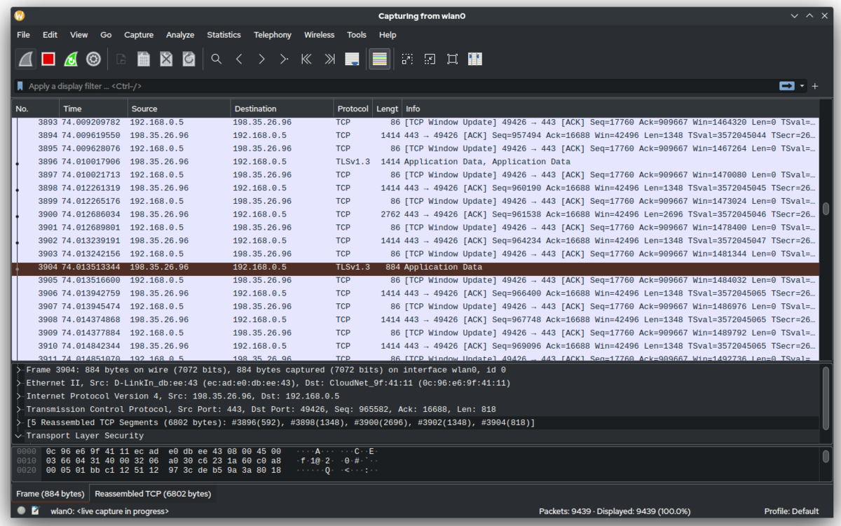


Slide 9
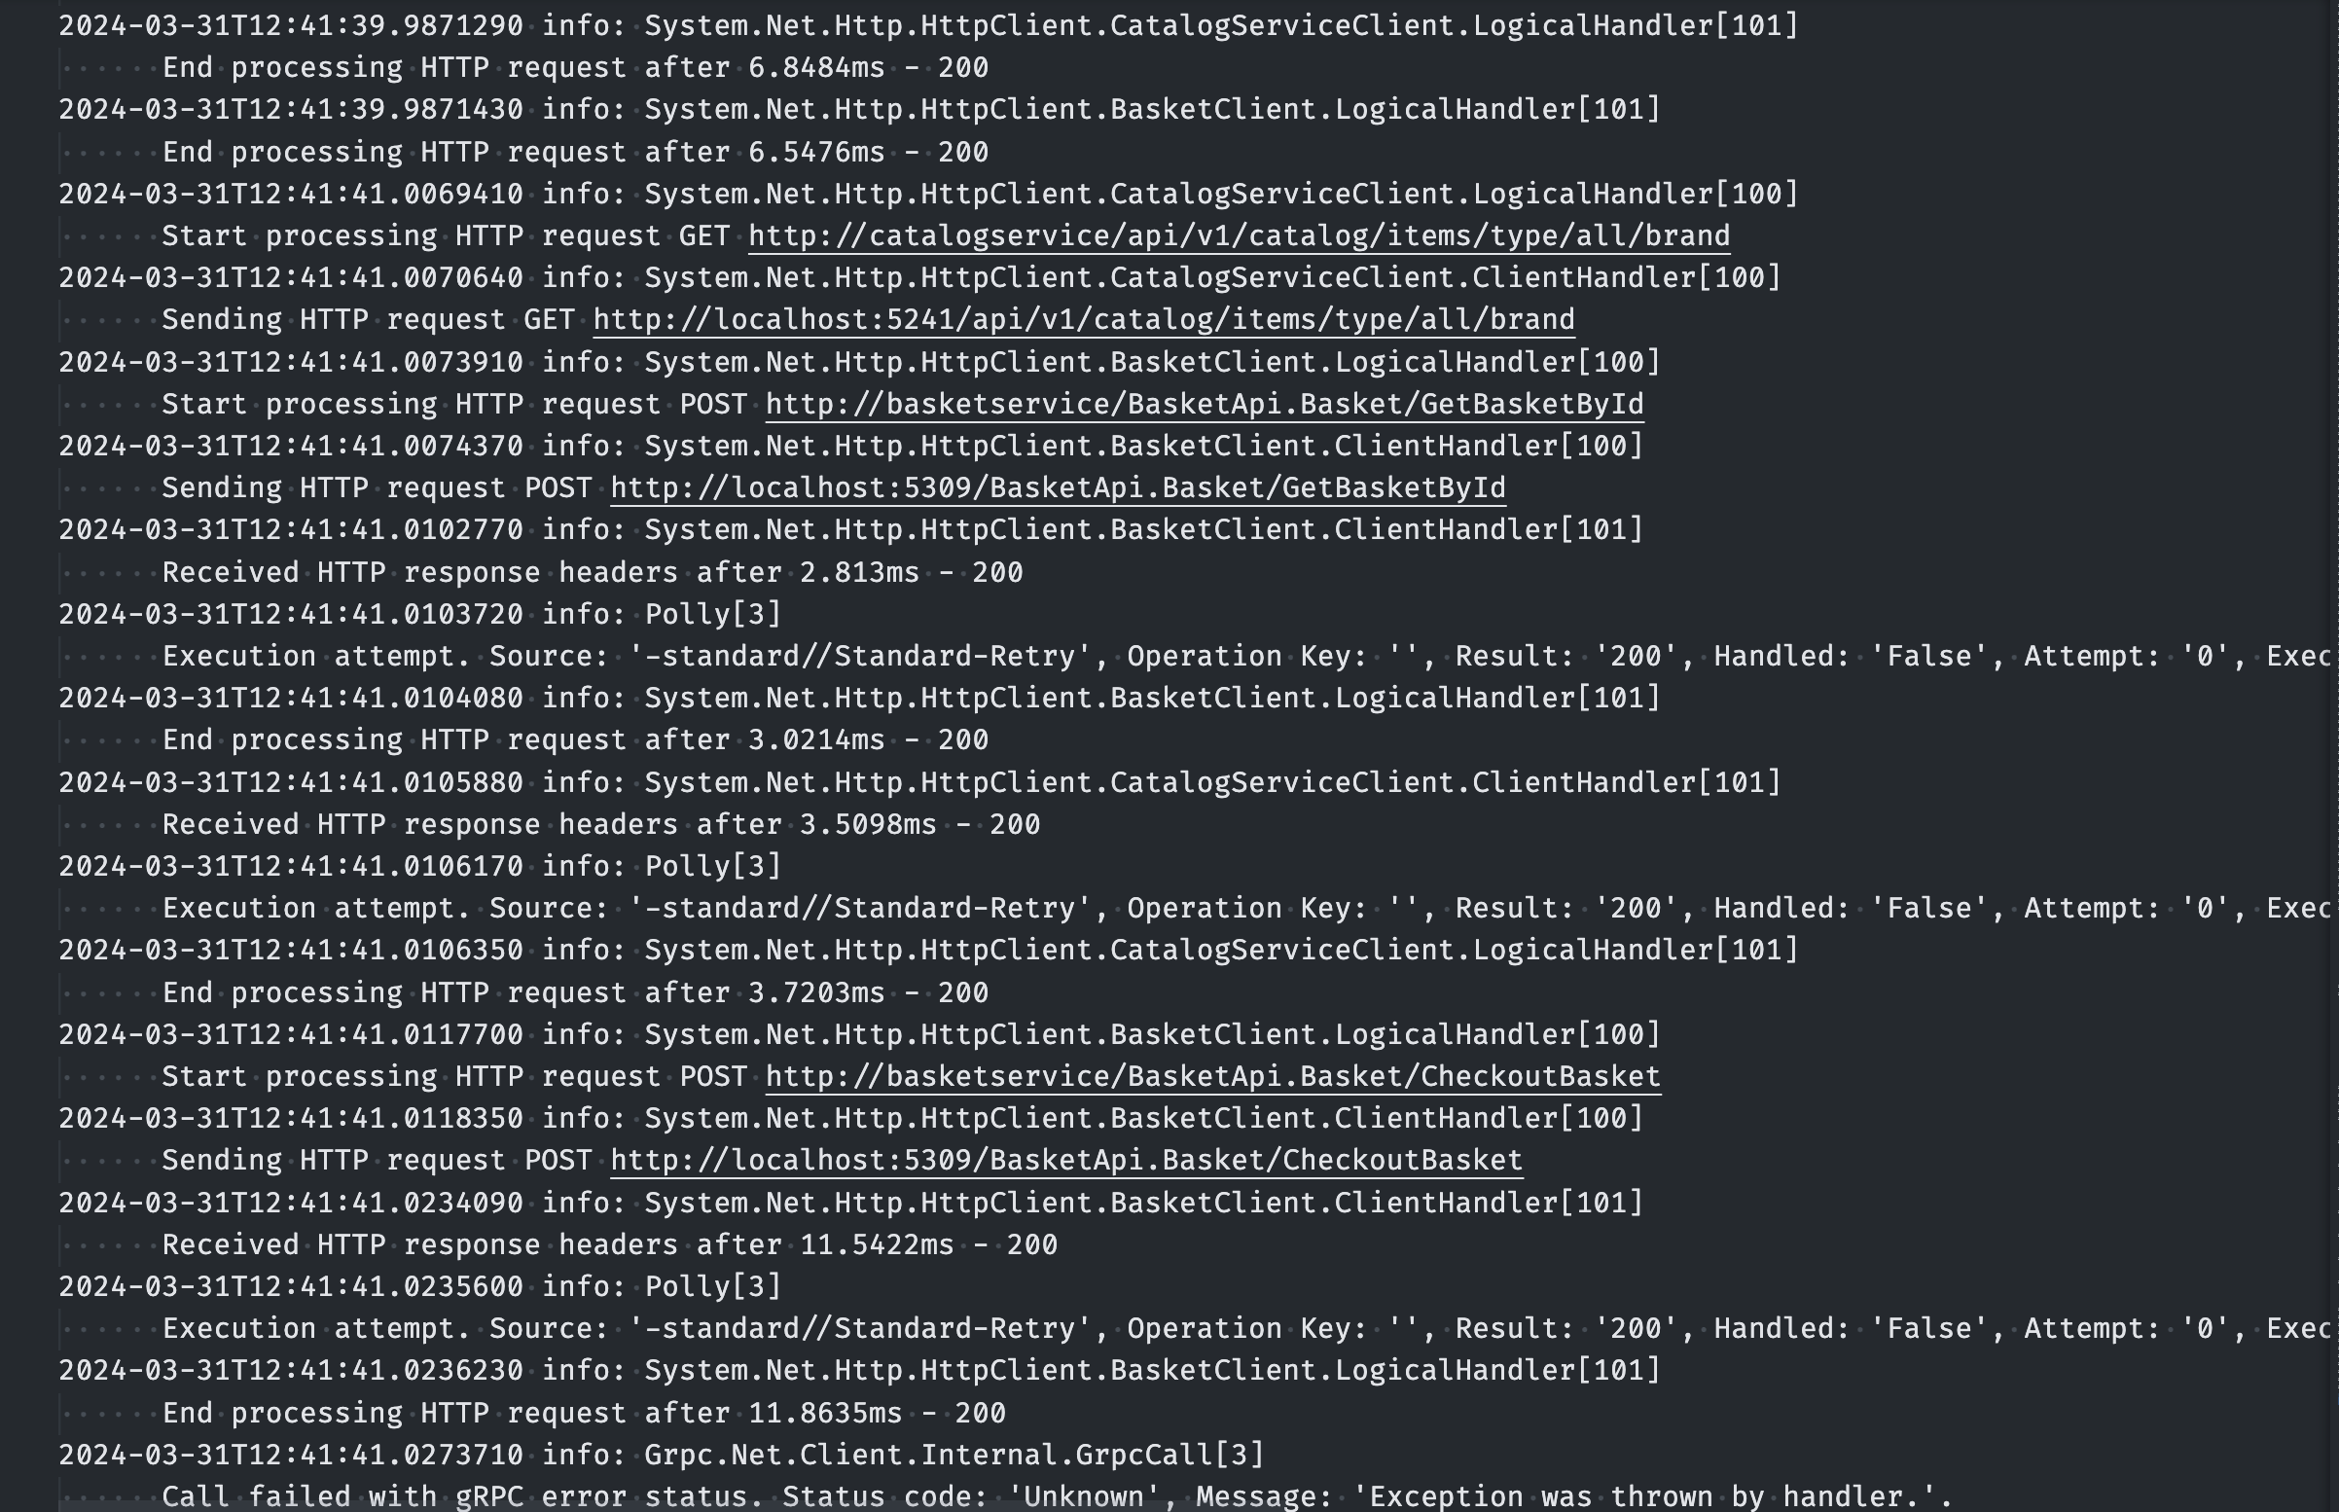
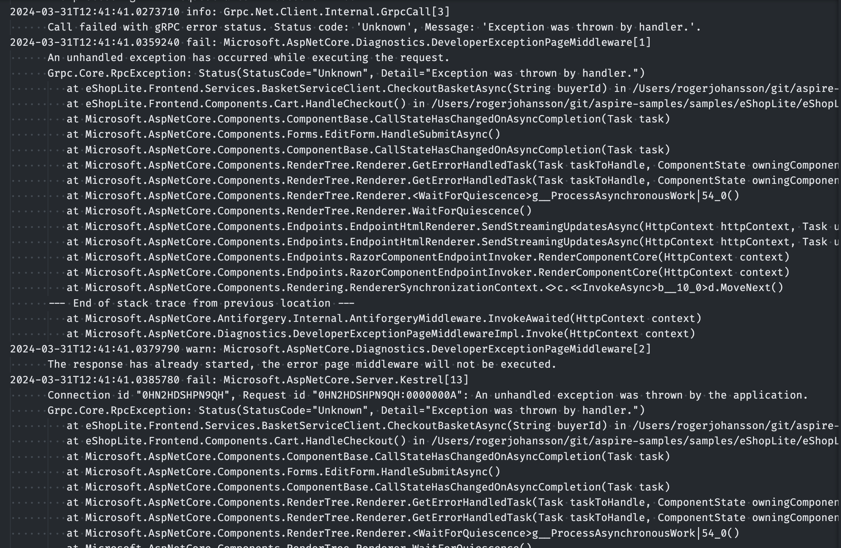
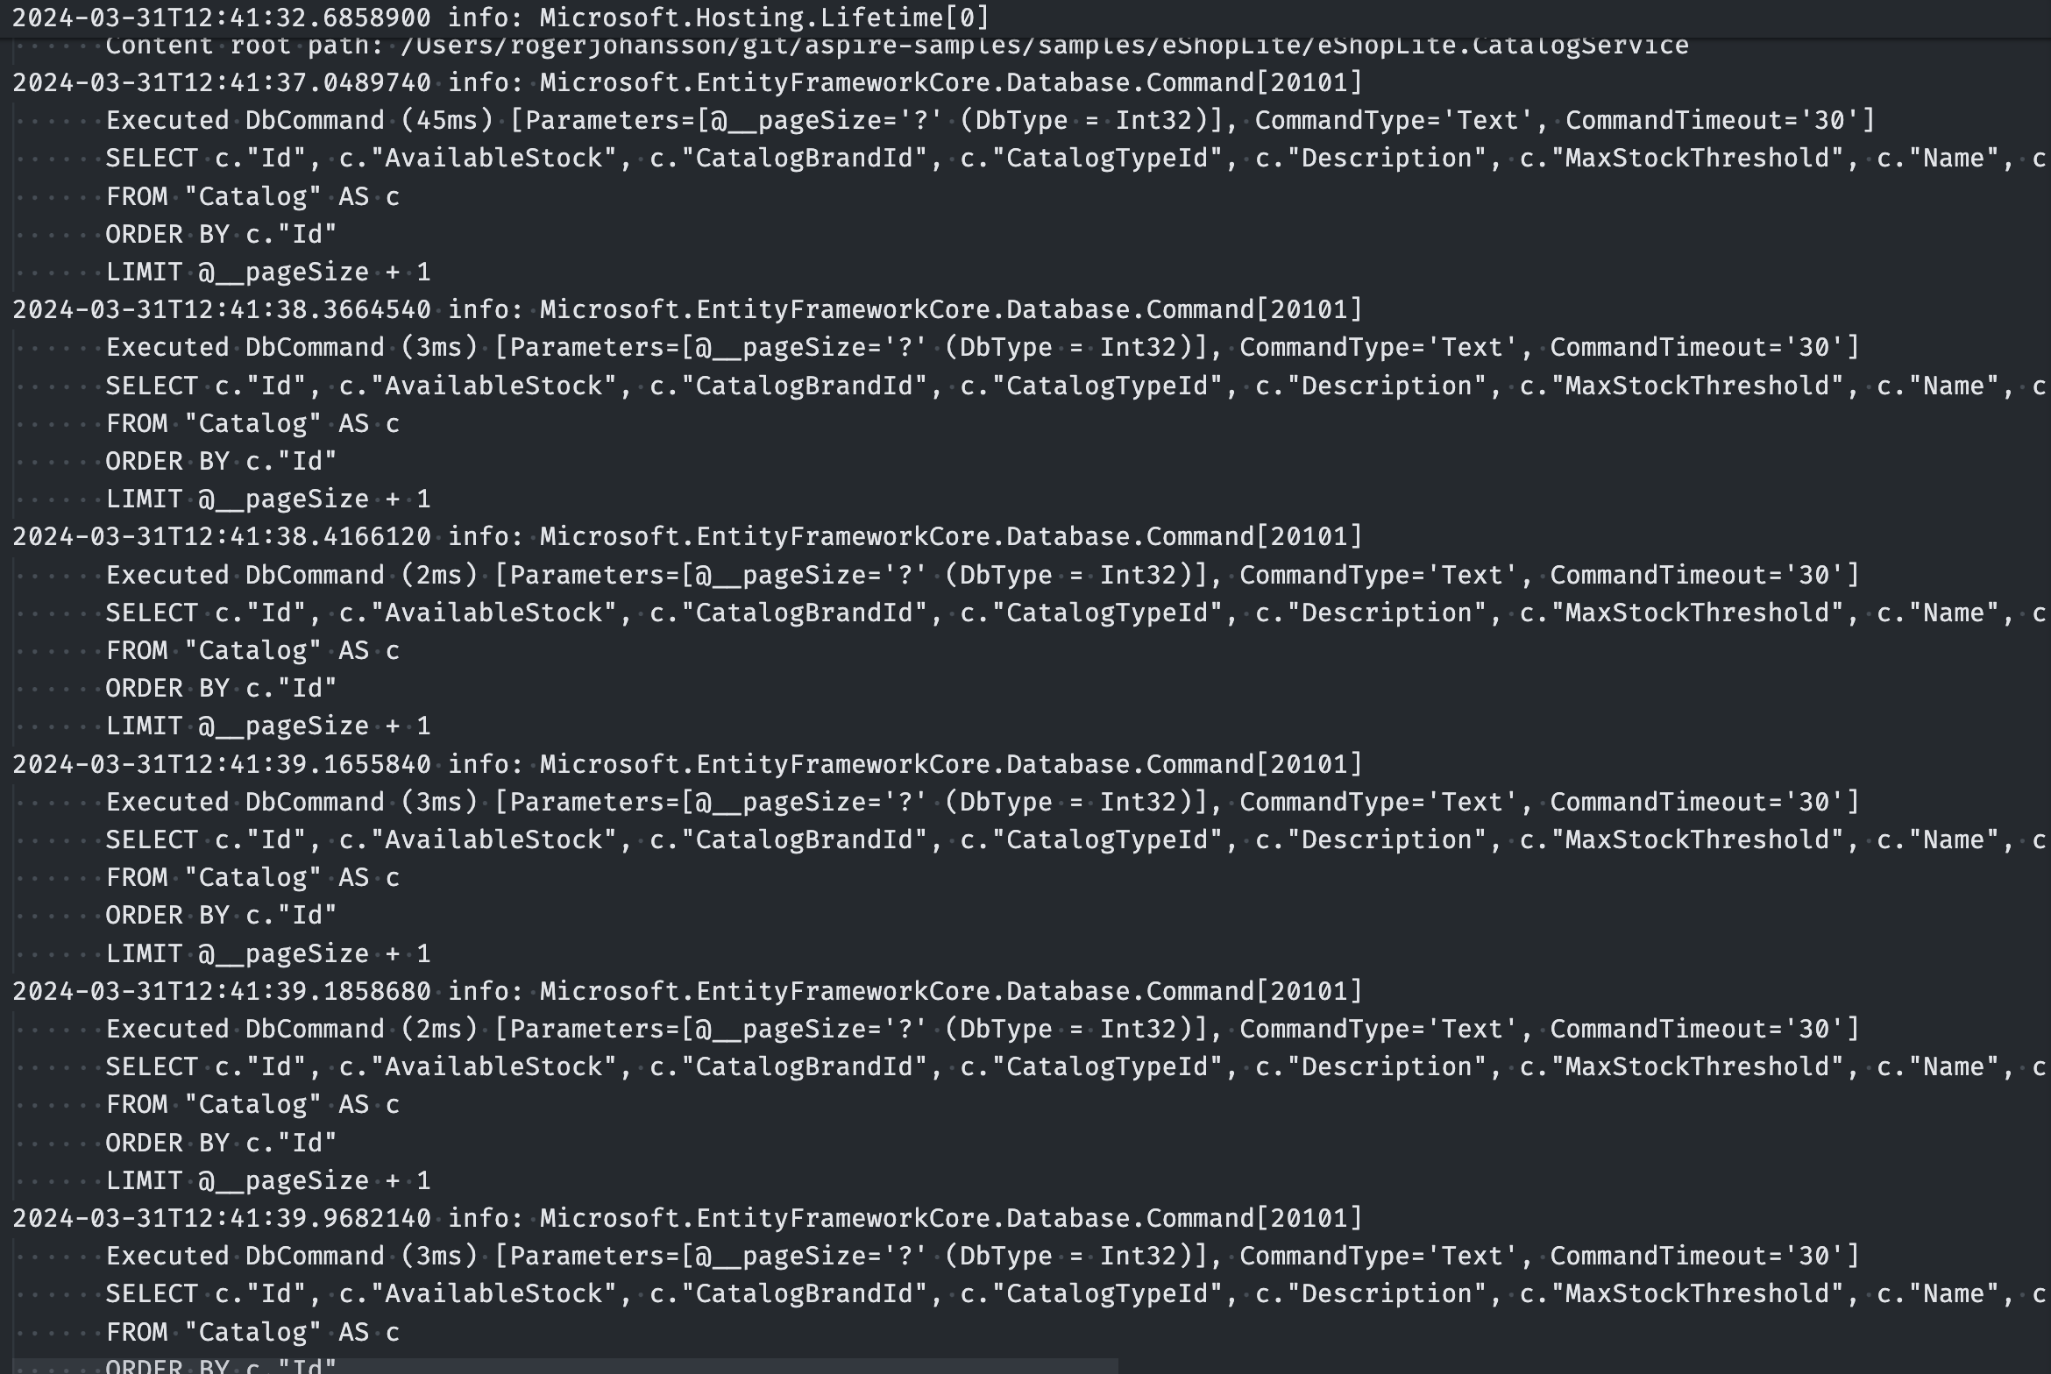

Slide 10
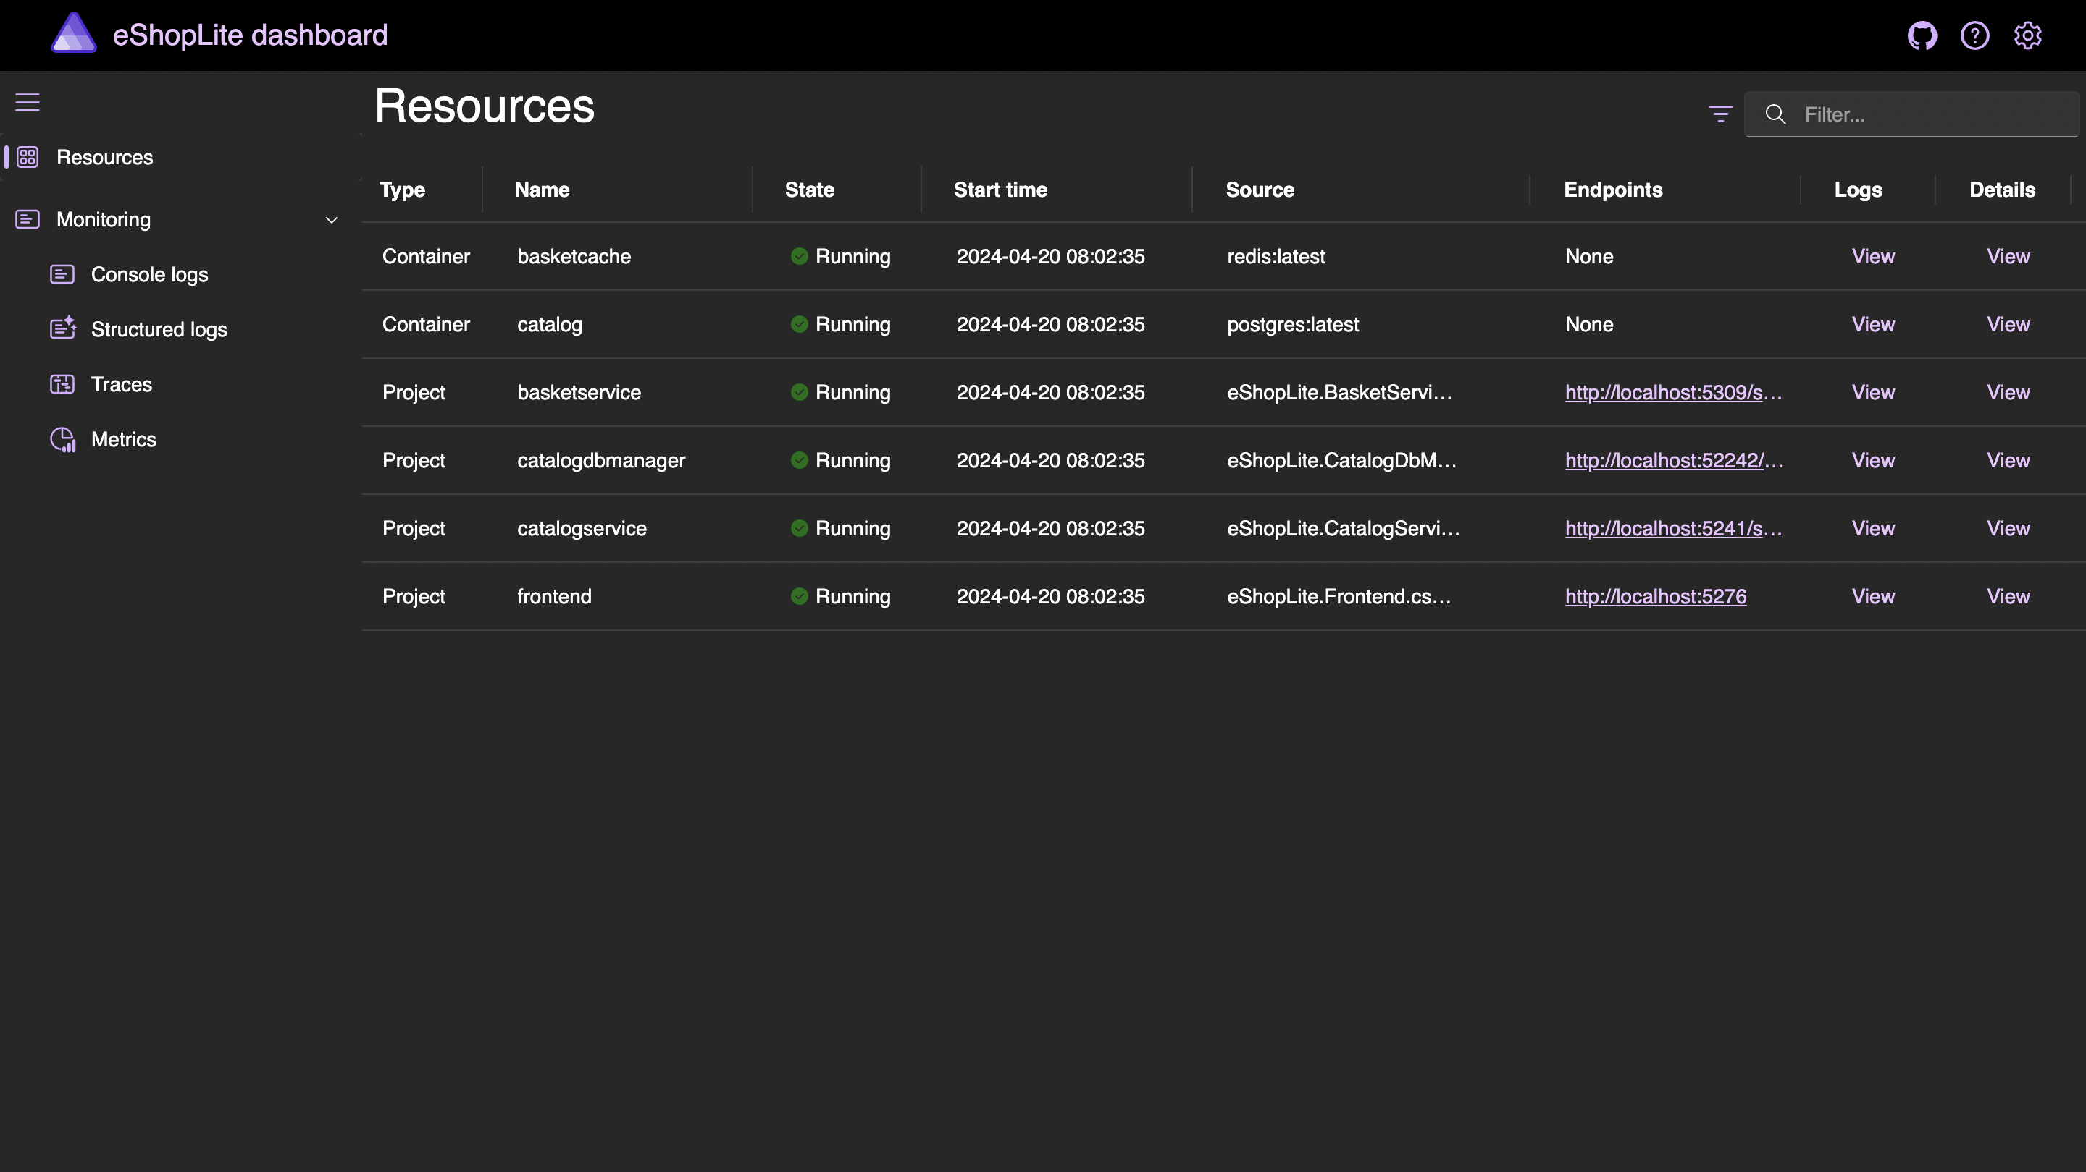

Slide 11
Catalog Service
Postgres
Frontend
Redis
Basket Service

Slide 12
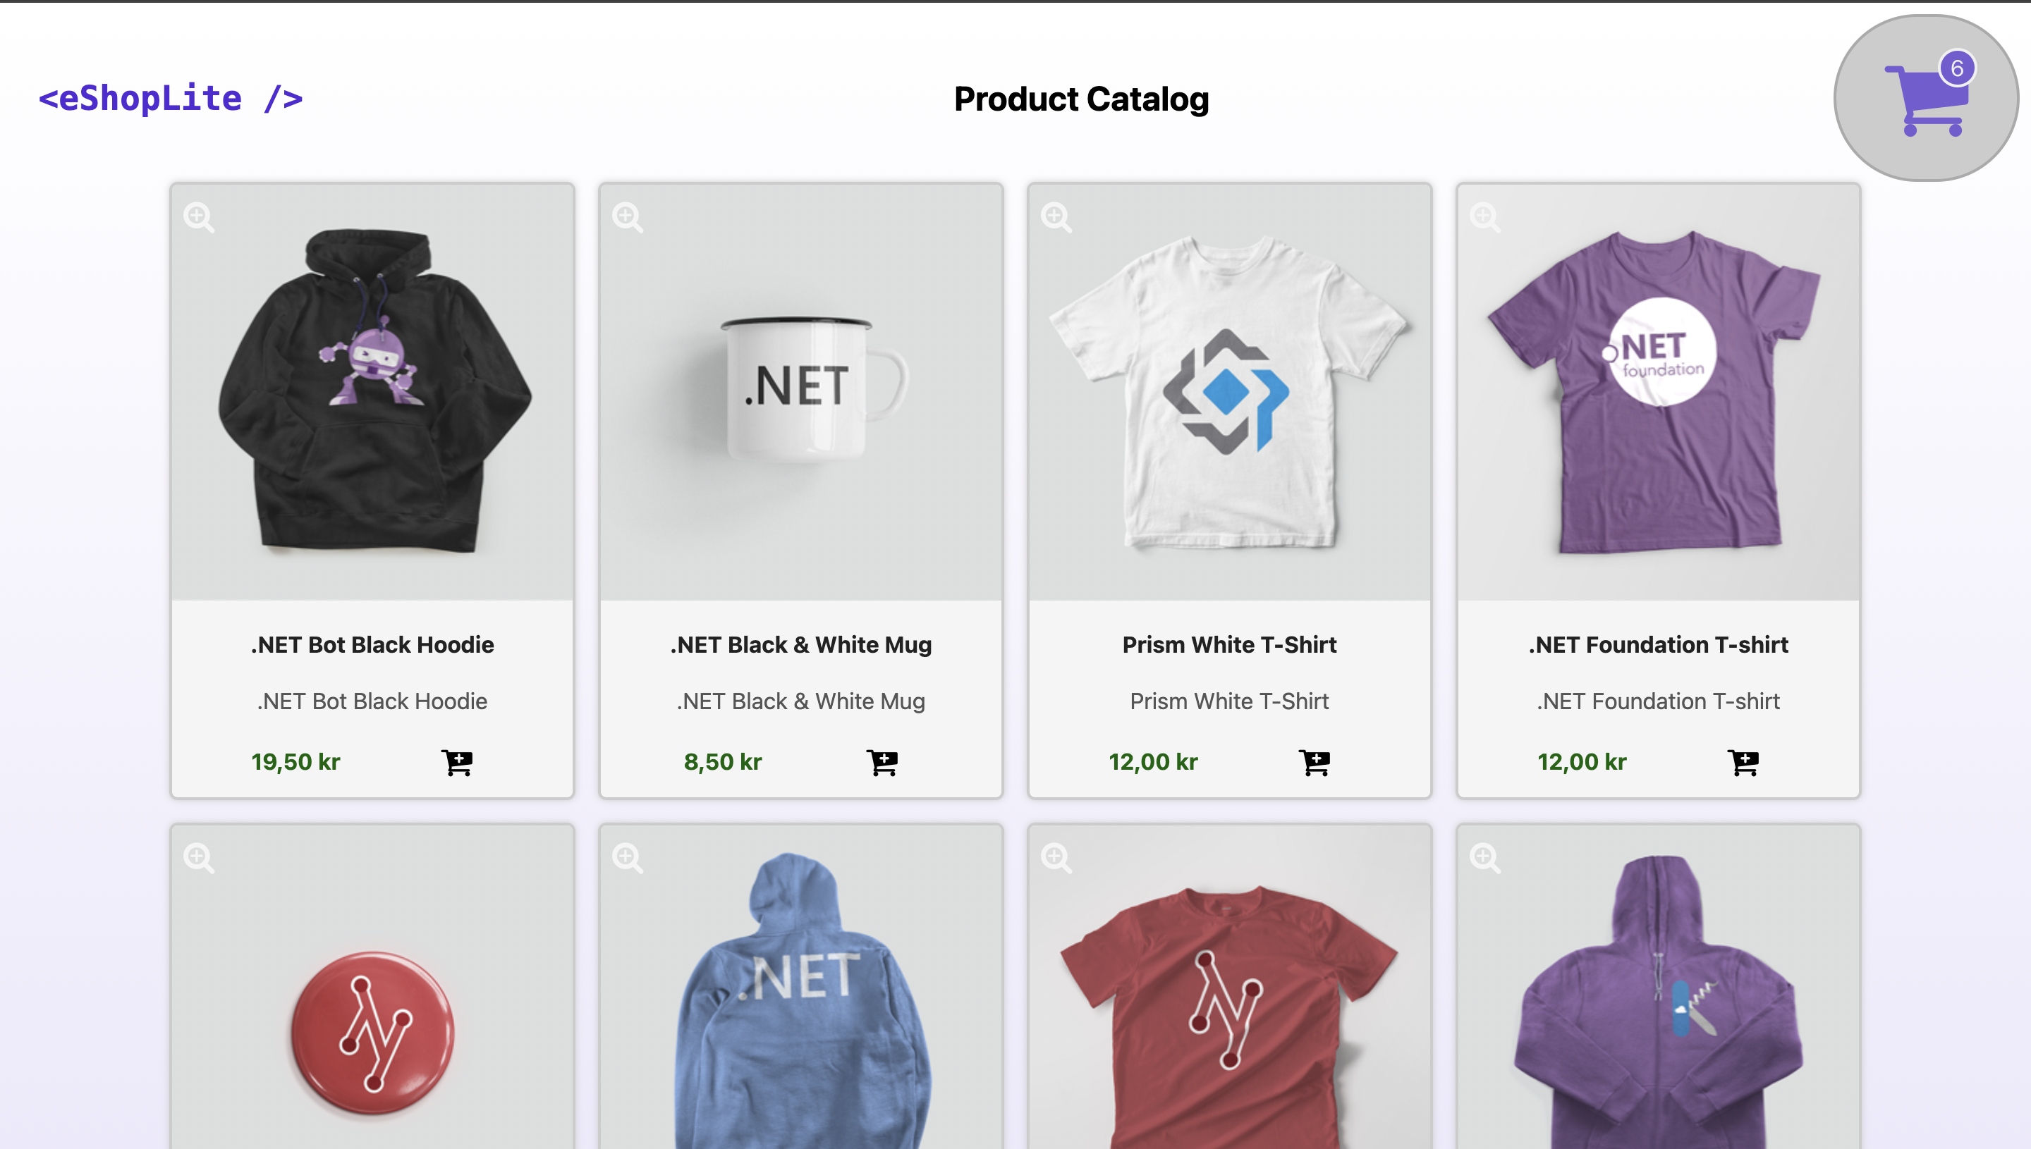
Aspire eShopLite Demo

Slide 14
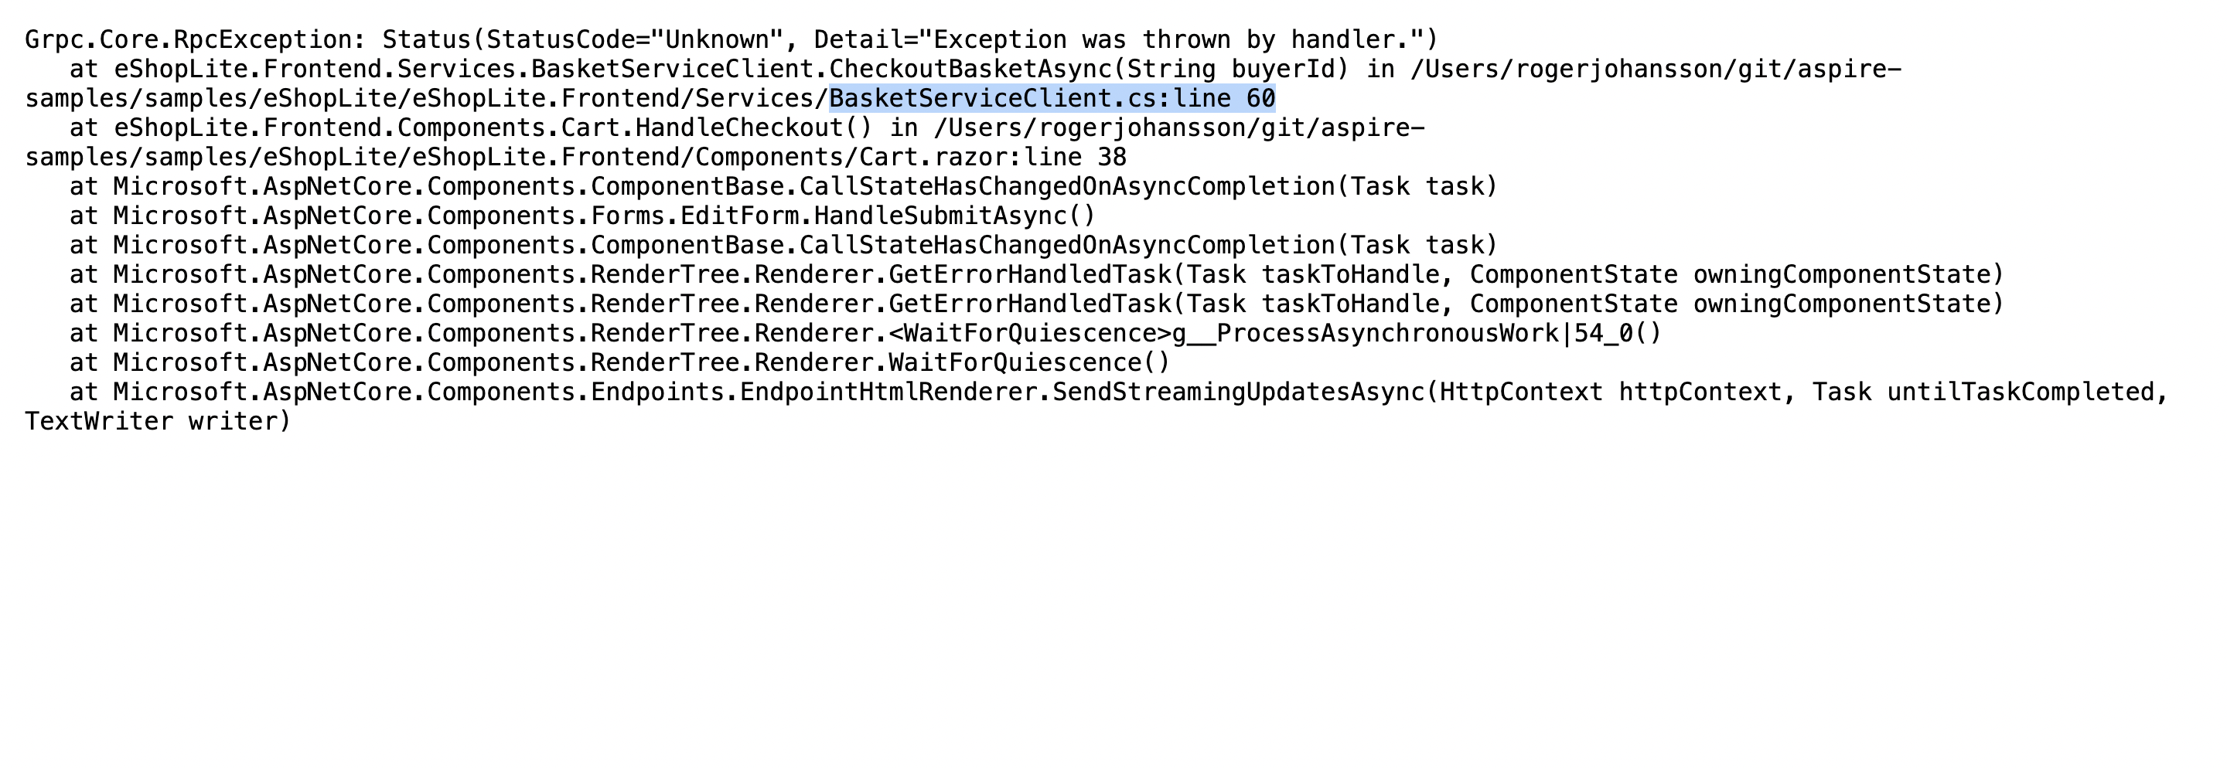

Slide 15
Catalog Service
Postgres
Frontend
Redis
Basket Service

Slide 16
Catalog Service
Postgres
Frontend
Redis
Basket Service

Slide 17

Catalog Service
Postgres
Frontend
Redis
Basket Service

Slide 18
Time to read the logs!

Slide 22
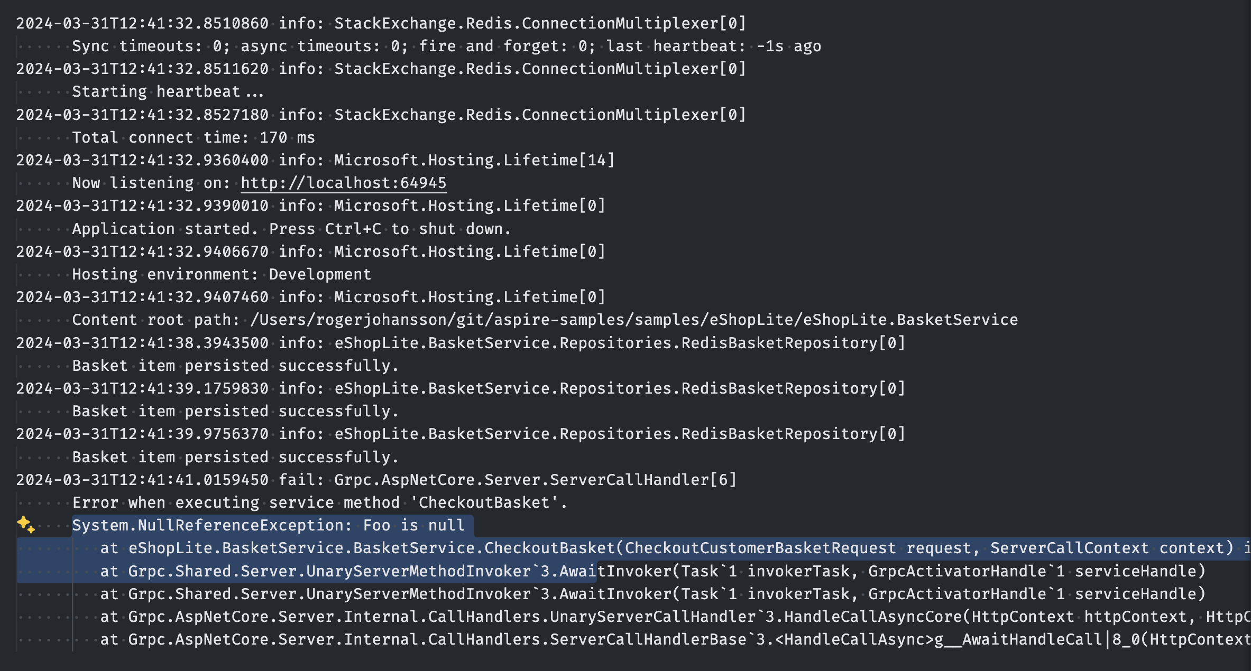

Slide 23
What if we could just see it?

Slide 24
Catalog Service
Postgres
Frontend
Redis
Basket Service

Slide 25
Catalog Service
Postgres
Frontend
Redis
Basket Service

Slide 26
Distributed Tracing

Slide 27
Time
FrontendService SomePage
CustomerService POST /api/customer
Postgres INSERT
CatalogService GET /price
Redis GET

Slide 28
Trace - a distributed call-graph
Time
FrontendService SomePage
CustomerService POST /api/customer
Postgres INSERT
Parent Span
CatalogService GET /price
Redis GET
Child Span

Slide 29
Tooling?

Slide 30
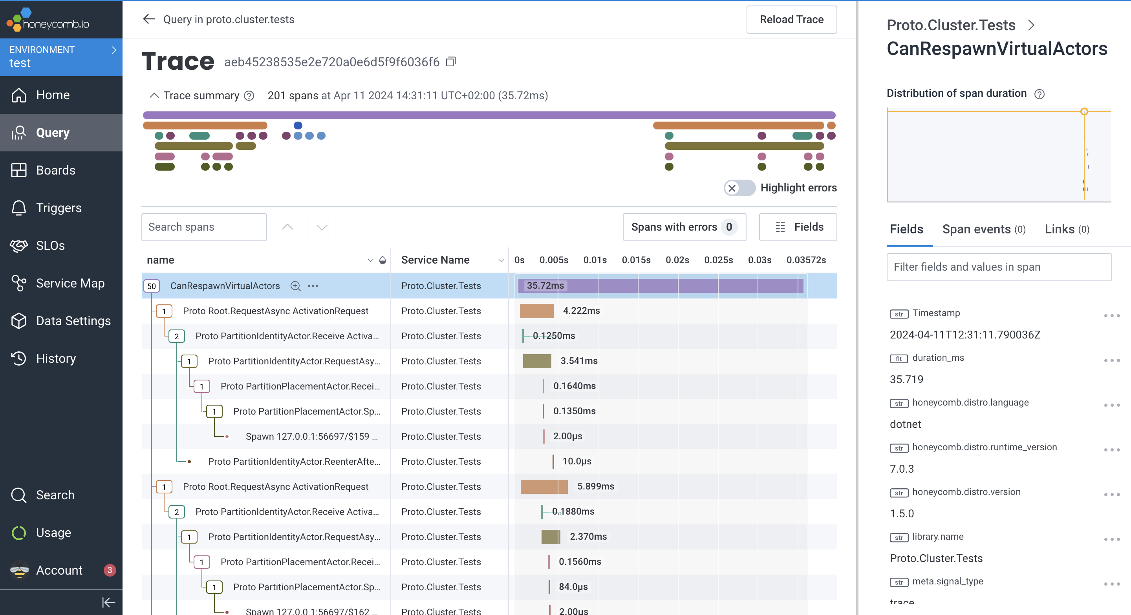

Slide 31
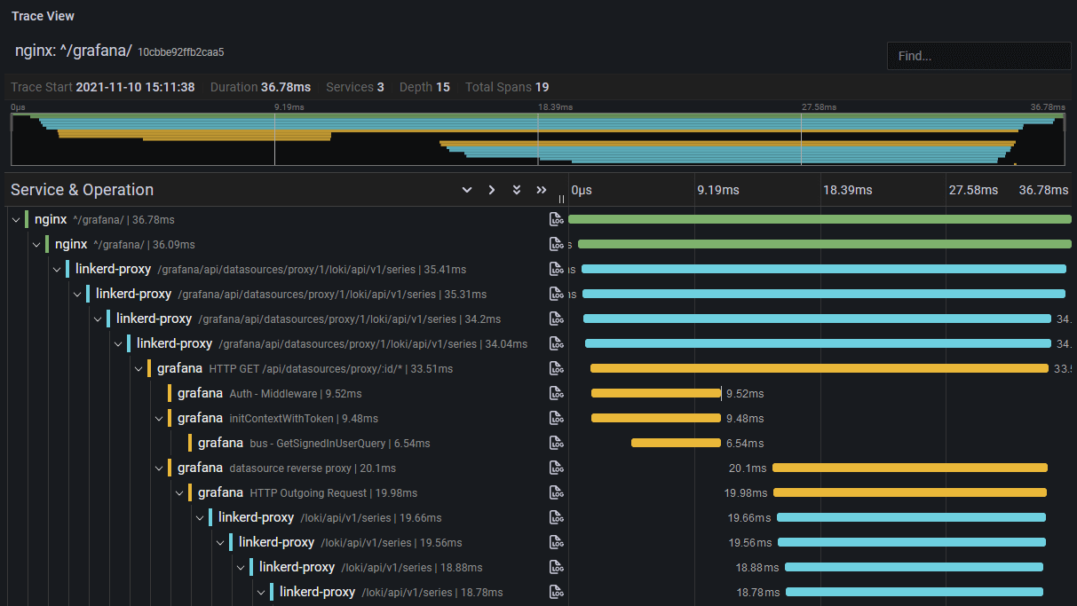

Slide 32
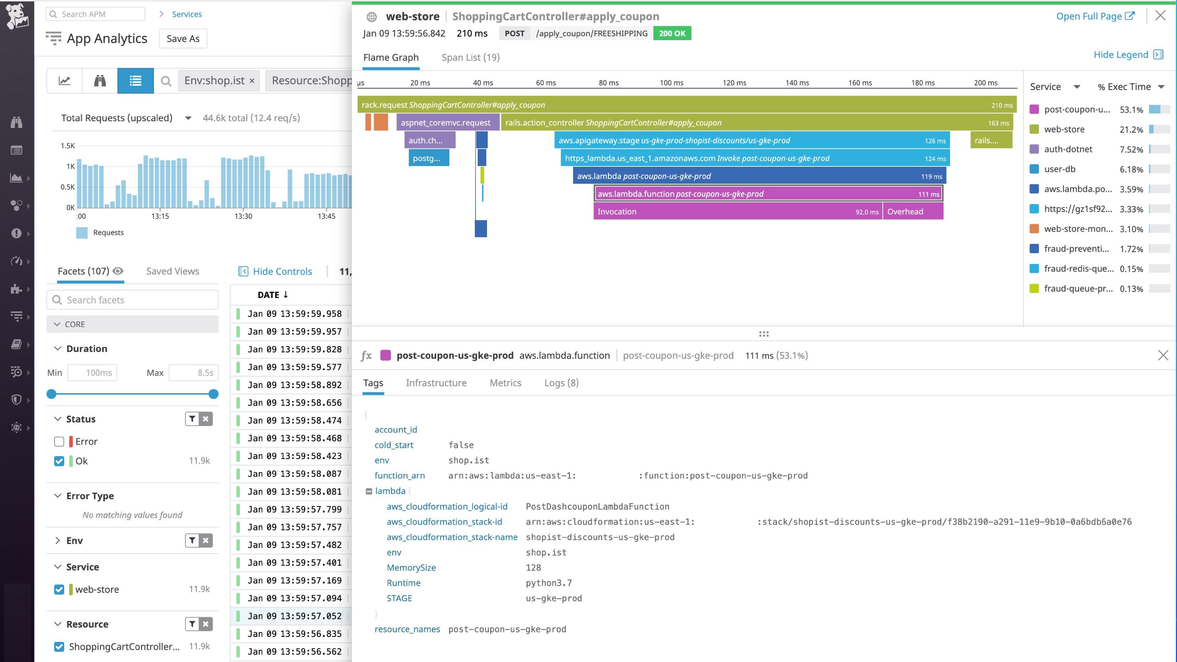

Slide 33
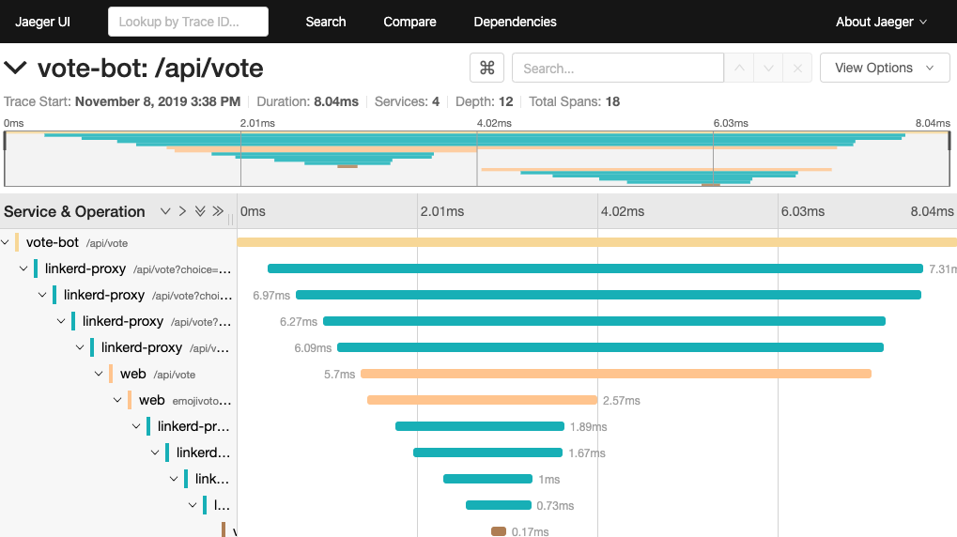

Slide 34
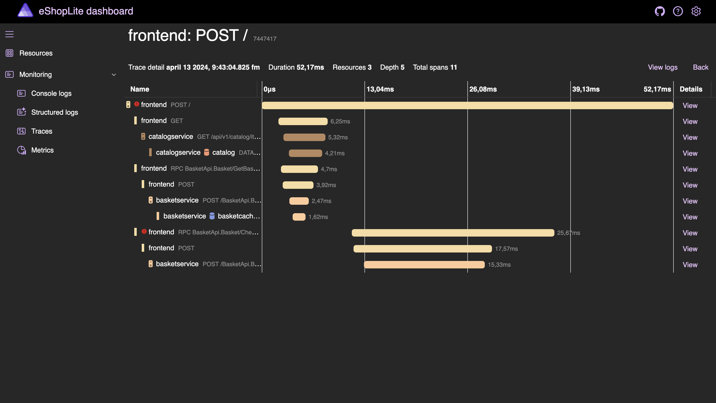

Slide 35
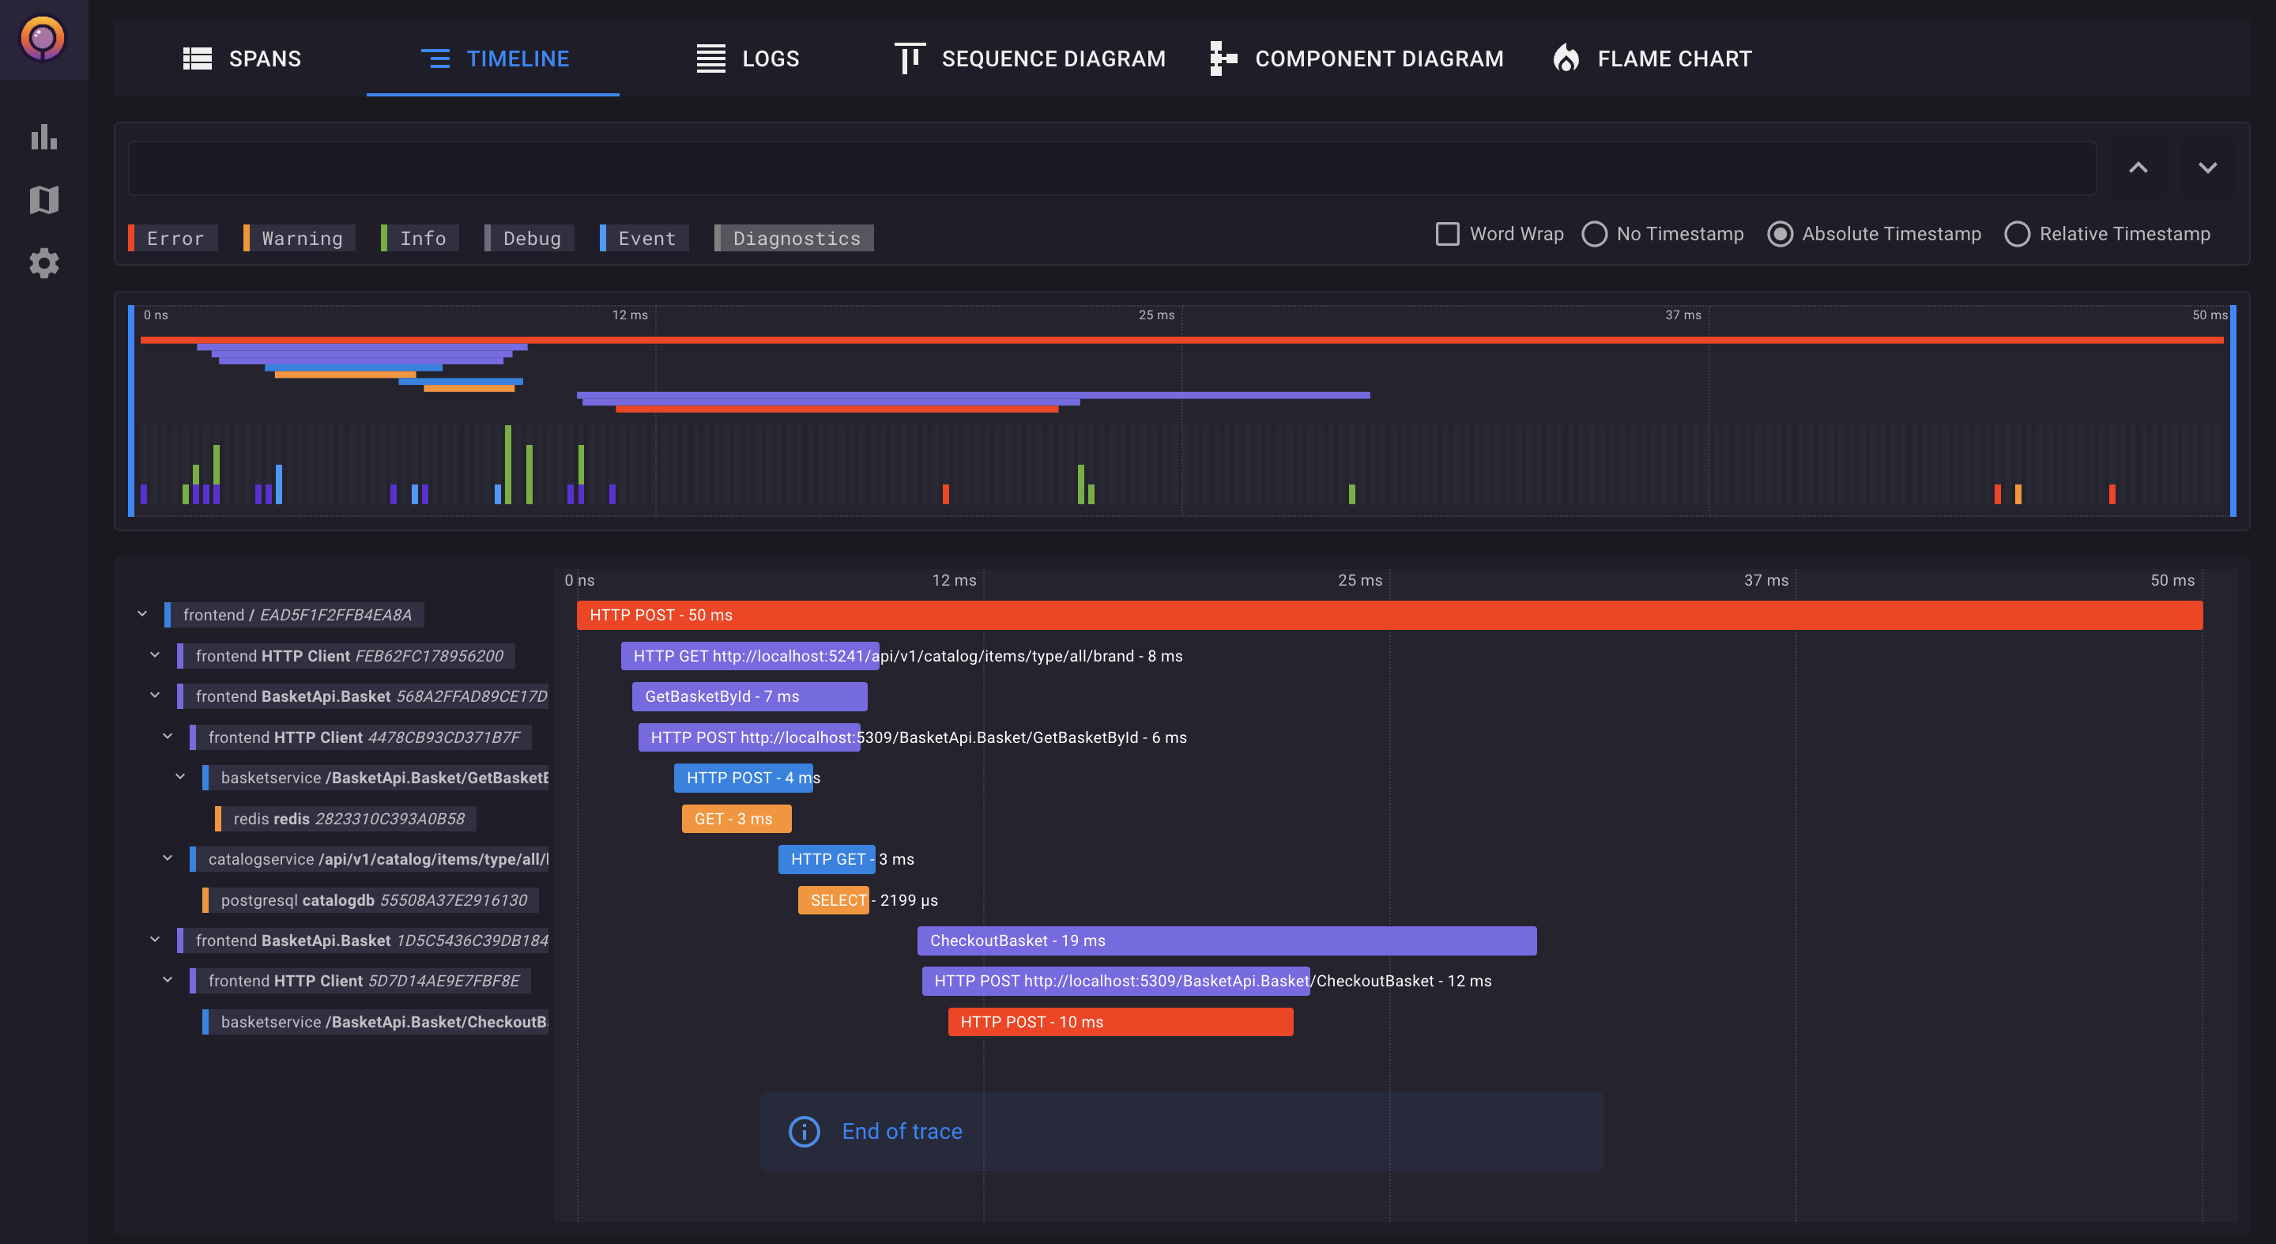

Slide 36
Profiler data

Slide 37
Time
FrontendService SomePage
CustomerService POST /api/customer
Postgres INSERT

Slide 38
Time
FrontendService SomePage
CustomerService POST /api/customer
CustomerService .SomeMethod
CustomerService.DataAccessLayer
Profiler Data
SqlClient
Postgres INSERT

Slide 39
Logs

Slide 40
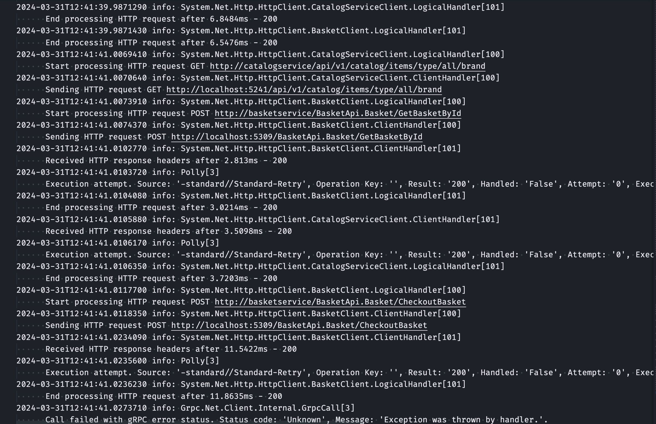
Time
FrontendService SomePage
CustomerService POST /api/customer
Postgres INSERT

Slide 41
Span
TraceId
SpanId
ParentSpanId
Attributes
Logs
TraceId
SpanId
Attributes

Slide 42
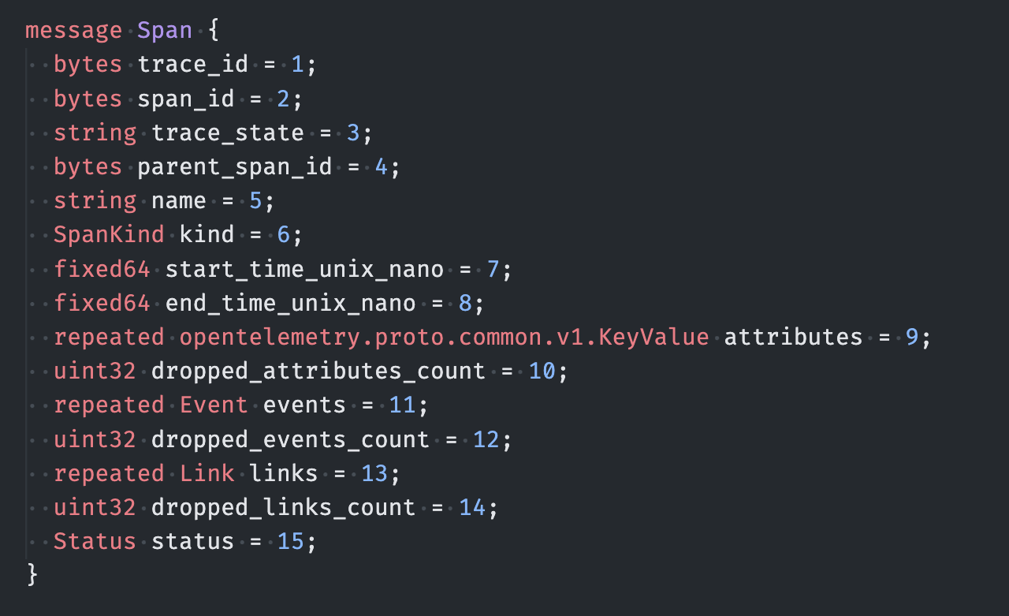

Slide 43
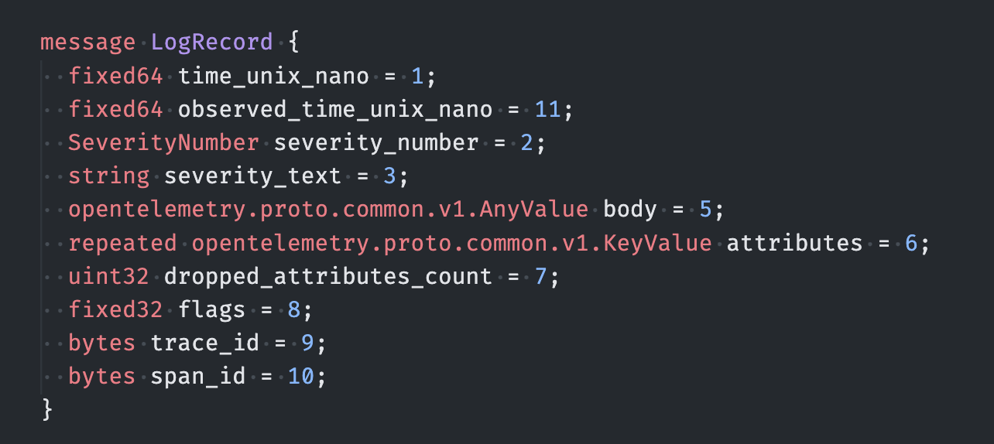

Slide 44
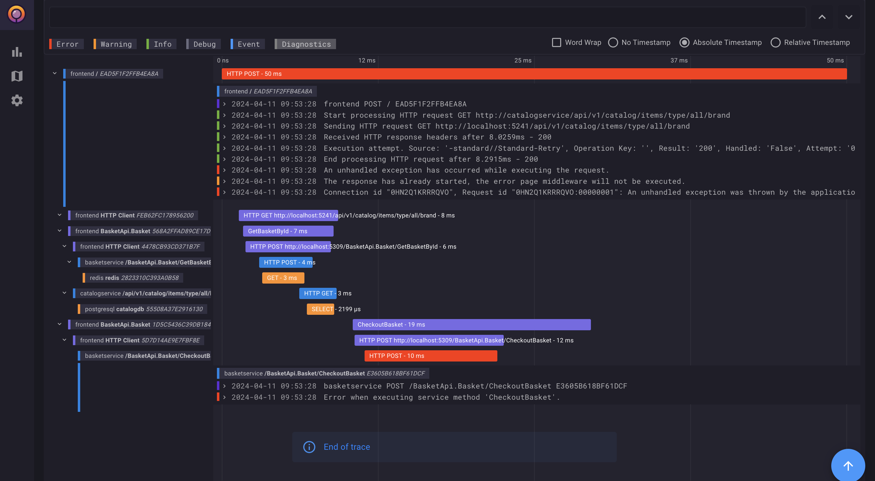

Slide 45
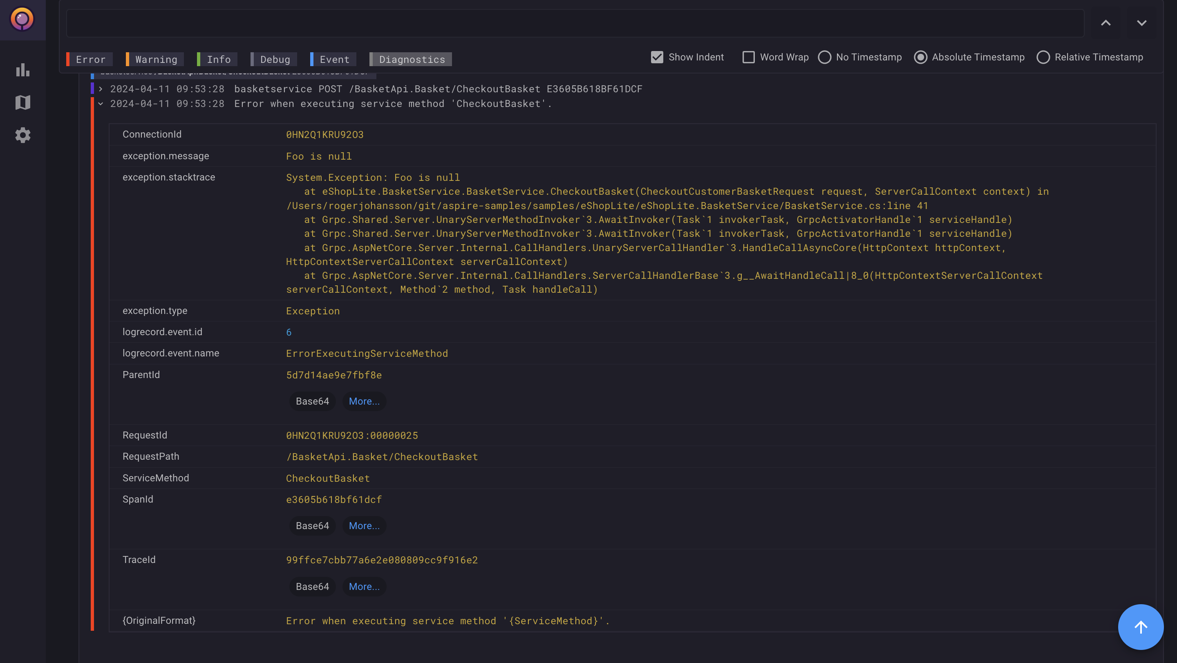

Slide 46
Baggage

Slide 47
Time
FrontendService SomePage
SomeKey: SomeValue
POST /api/customer
SomeKey: SomeValue
Postgres INSERT
SomeKey: SomeValue

Slide 48
Use-cases for Baggage?
Baggage is intended to enrich other telemetries.
It is not intended to be used by application logic.
e.g. it is not intended to carry a session-id across services so that services can _use_ that.
It is rather intended to enrich other telemetries with such data. e.g. add session-id or user-id to metrics or spans in services that don´t have that data as part of their contracts

Slide 49
Metrics

Slide 50
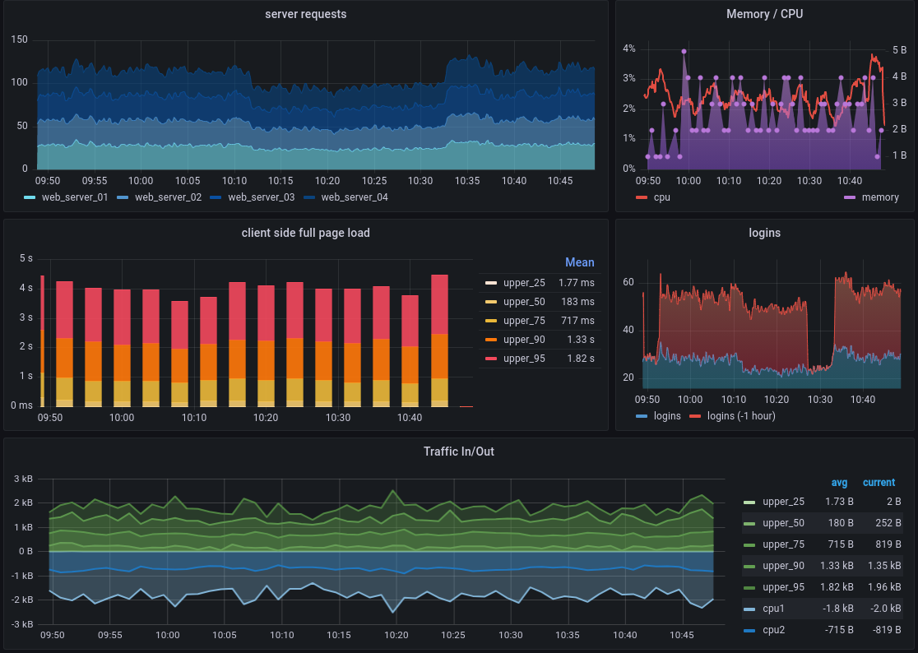

Slide 51
Collector

Slide 52
MyService
Otel Exporter
OpenTelemetry protocol
Otel Collector
3rd party integration
Grafana / DataDog / Jaeger etc

Slide 53
MyService
Otel Azure Exporter
Custom Protocol
Azure ApplicationInsights

Slide 54
MyService
Otel Exporter
OpenTelemetry protocol
Otel Collector API
TraceLens

Slide 55
MyService
Console
Logs
OpenTelemetry protocol
Promtail
Otel Collector
3rd party integration
Grafana

Slide 56
Why not console scraping?
If you are logging in plain text. You might have problems linking the logs to traces and spans.. E.g. you must somehow also pass the trace id, span id
Word-wrapping, long lines might be scraped incorrectly
If you are logging JSON data, this will likely come with parsing issues due to the above. And your console logs will be hard to read
Console logging is thread blocking in .NET!!

Slide 57
Code Demo - HowTo

Slide 58
Correlating Logs and Spans

Slide 59
Visualizing your system

Slide 60
This is a graph

Slide 61
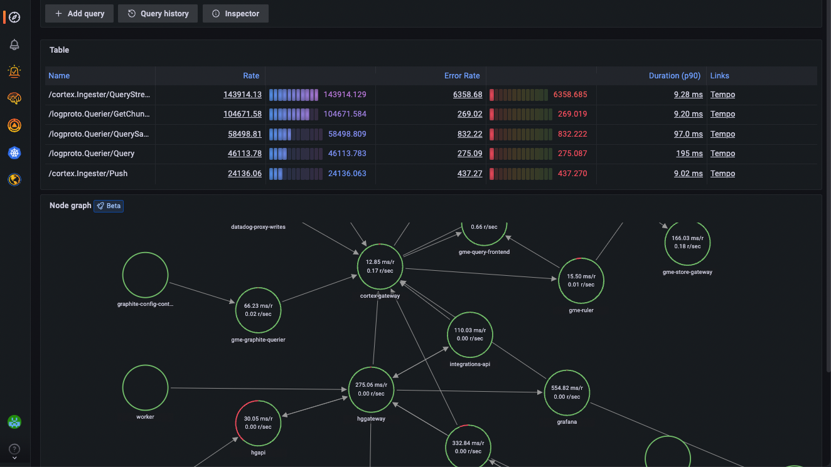

Slide 62
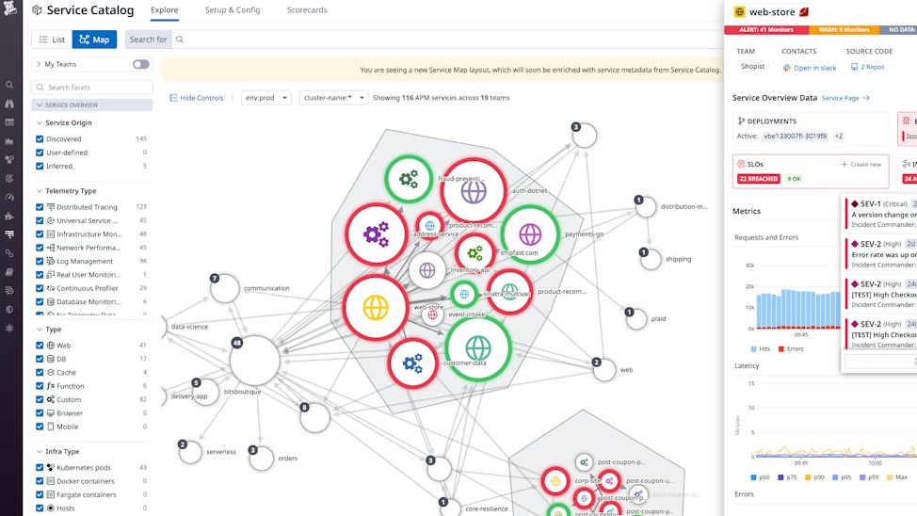

Slide 63
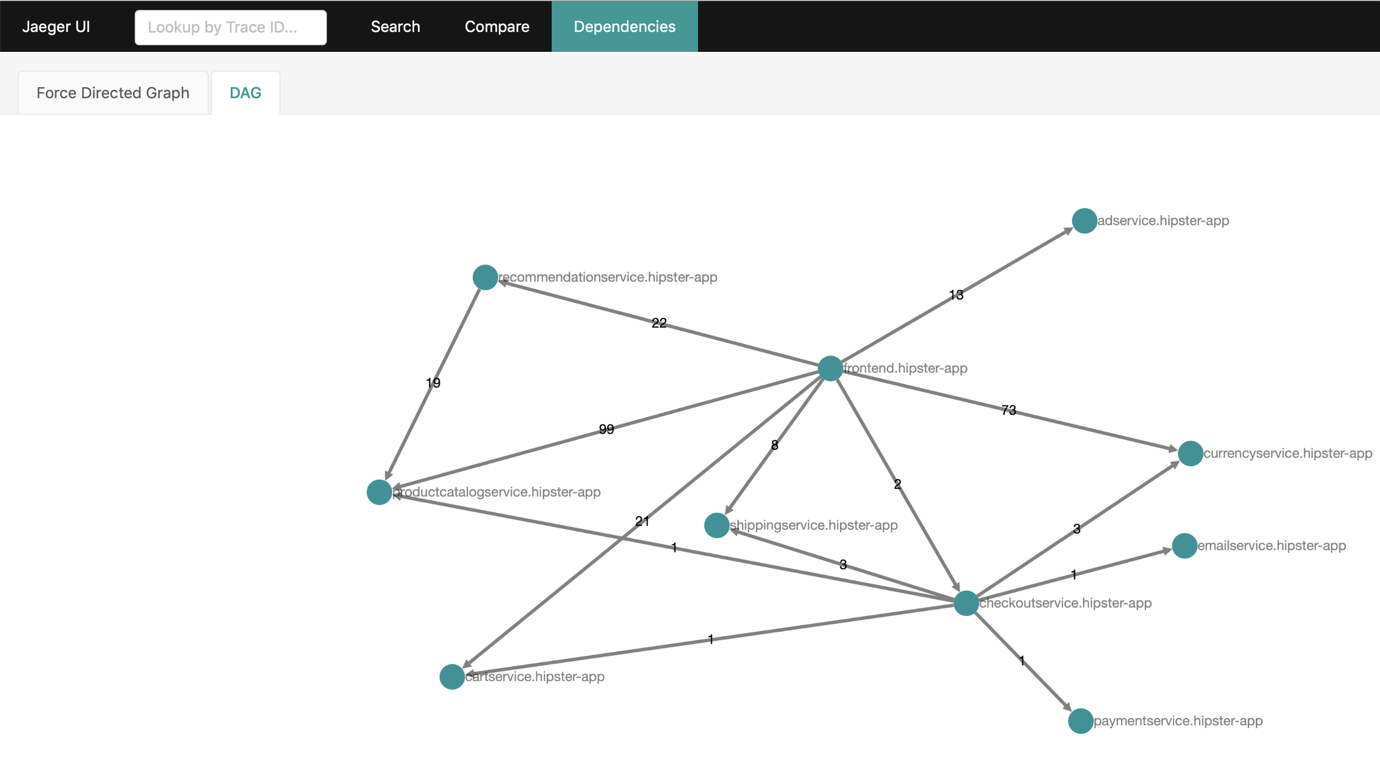

Slide 64
Can we do more?

Slide 65
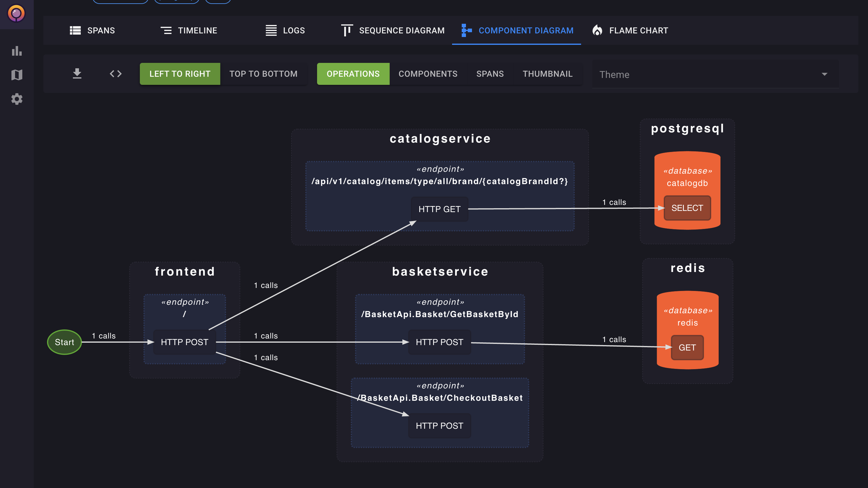

Slide 66
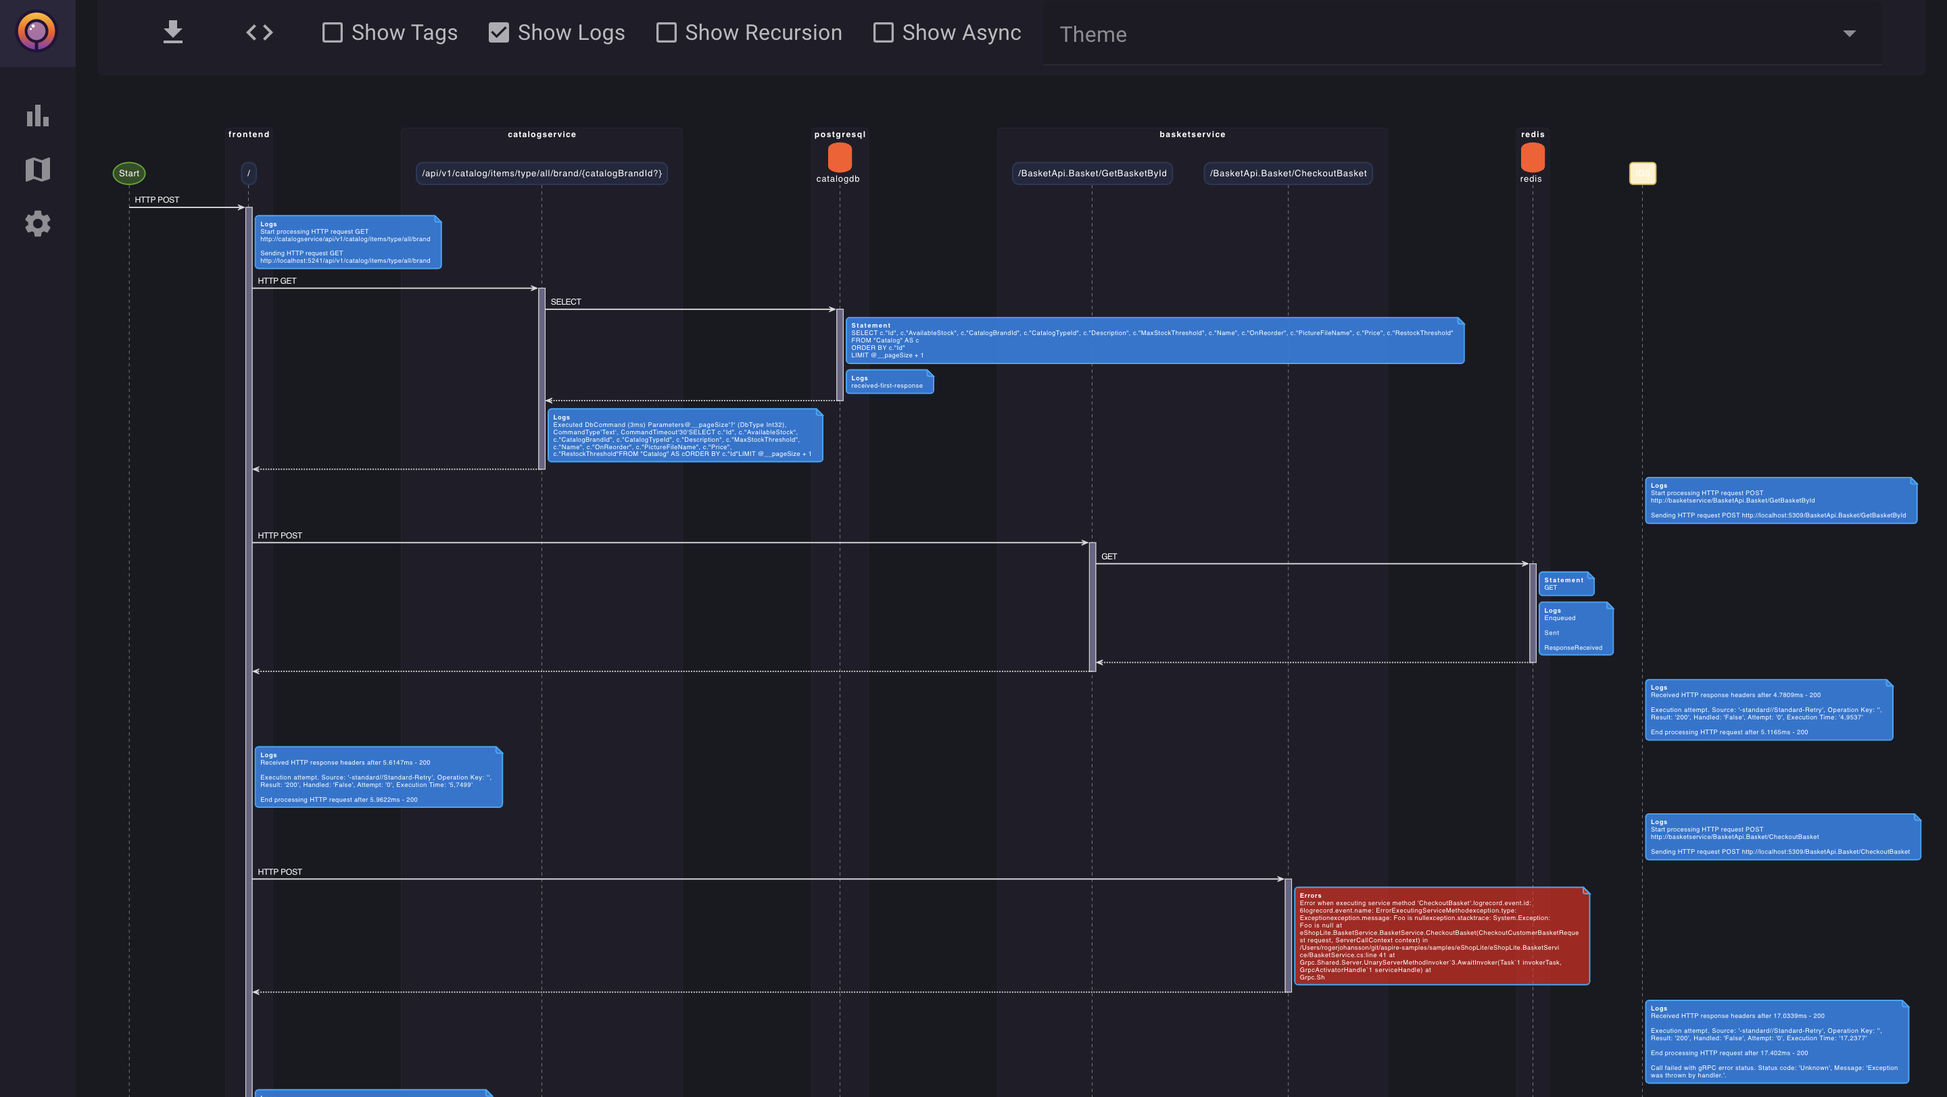

Slide 67
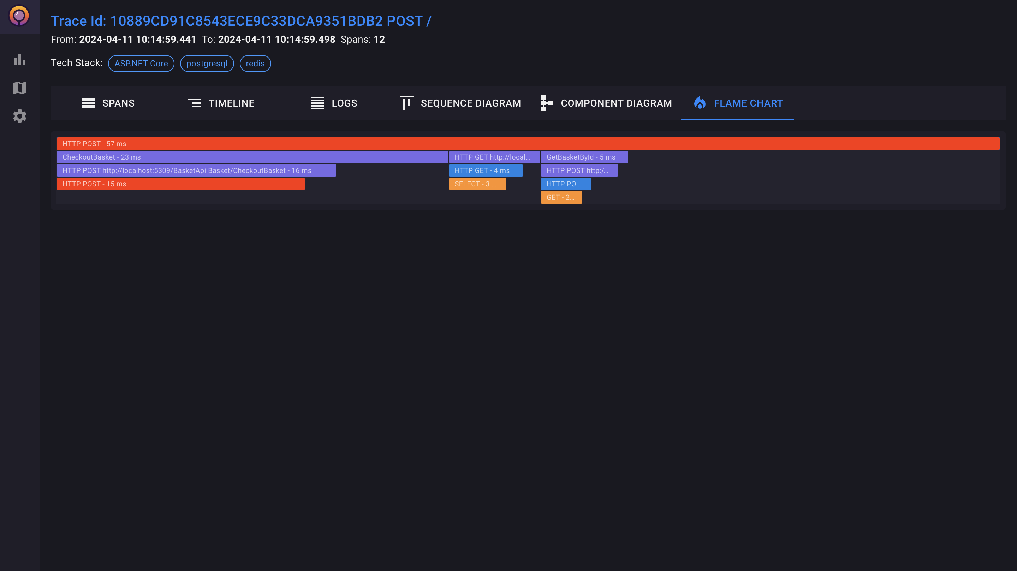

Slide 68
OK, Great, But what is the cost?

Slide 69
Overhead when using HTTP
traceparent: This header carries the trace ID, span ID, and flags. It's part of the W3C Trace Context specification and is crucial for maintaining trace continuity across different services that might use different tracing systems.
tracestate: This header complements traceparent by logging the trace's state across services. It can be used by vendors to add vendor-specific tracing information that may not be covered in the traceparent.

Slide 70
Overhead
Performance overhead
Transferring string-based key-value pairs adds a fairly large overhead to data payloads, especially when using size-optimized binary protocols. For example, if your payload is just a few bytes, then adding an additional ~50 bytes in the form of text can be significant.
TLDR: Performance = $$$

Slide 71
Overhead
Storage cost
Trace data needs to be stored in some form of database to allow searching and reasoning about your traces.
If your system experiences high traffic, this can result in large data volumes.
TLDR: Storage = $$$

Slide 72
Sampling
Sampling allows you to only apply tracing to a subset of all requests in your system.
OpenTelemetry supports various ways to sample your requests.
e.g. ParentBasedSampler and TraceIdRatioBasedSampler
Tracing fewer calls, means less performance impact, and less data sorage required.

Slide 73
Considerations, async spans
Not async as in async await.
But async as in concurrent.
Example: OCPP EV-Charger protocol.
Client sends Requests, Server sends Responses
And…
Server sends Requests, Client sends Responses
Are those two separate traces? Is it one trace?

Slide 74
Considerations, long vs short traces
A challenging aspect of designing traces is deciding their length. Should traces be long-running or short?
For instance, if you have workflows that span many days, should this be recorded as a single trace, or should it comprise several smaller traces?

Slide 75
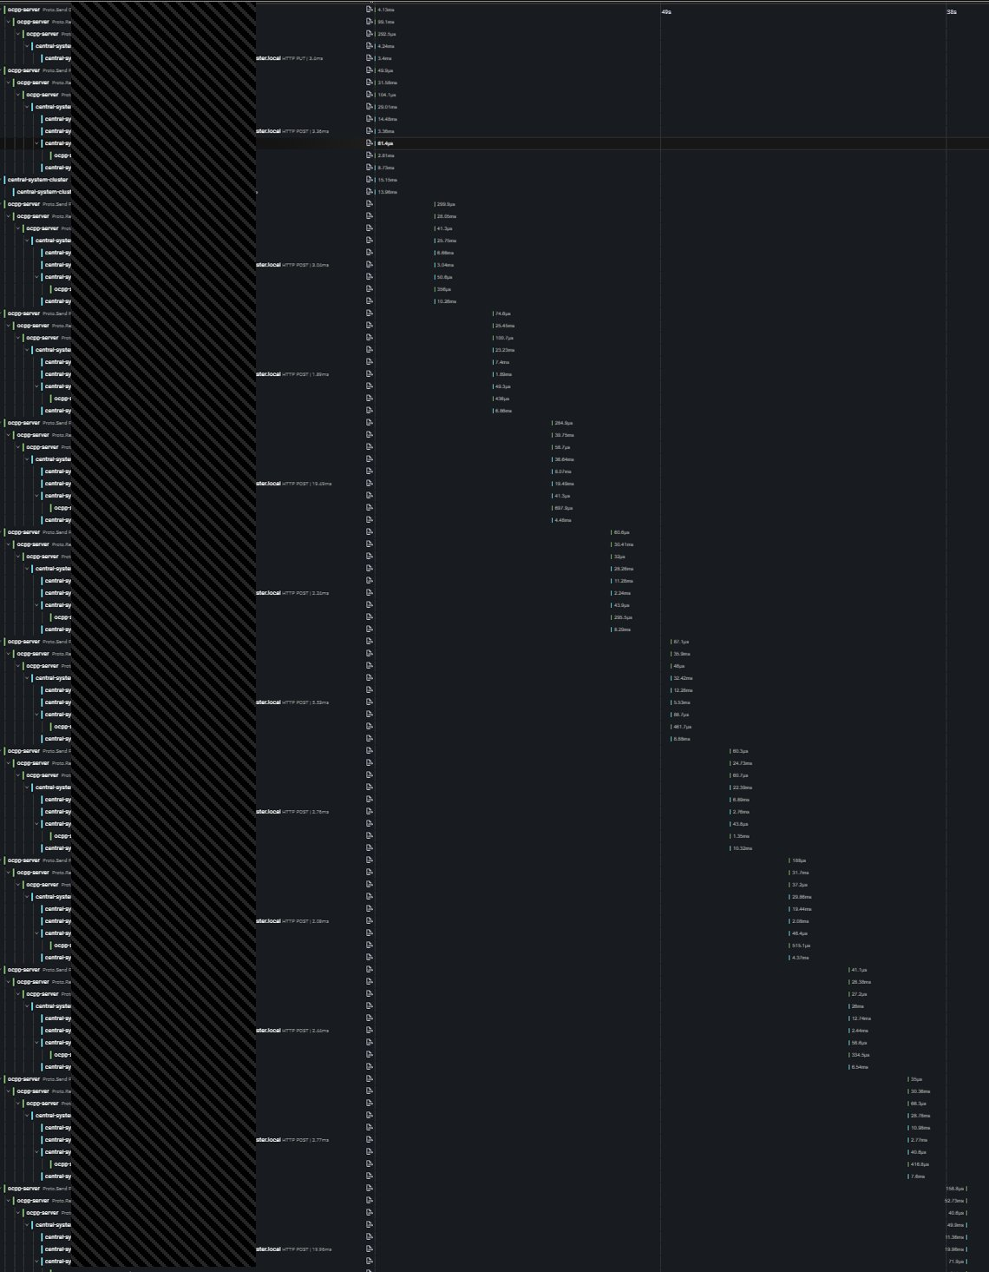

Slide 76
Considerations, attribute cardinality
This is more of a consideration for what backing tools you use.
But in general, many of the established tools like DataDog, Grafana etc are bad at managing high cardinality.
e.g. Key ”GPSPosition” Value ”123.3242, 54.43453”
This is not an issue with Otel, but rather with time-series databases

Slide 77
Considerations, span names
Very much related to previous slide.
You _can_ name your spans whatever you want.
But, it can have implications on how the tools list or display them.
e.g. endpoint span /api/customers/1234
Rather go with: /api/customers/{customerid}

Slide 78
Demo Proto.Actor Cluster Tests

Slide 79
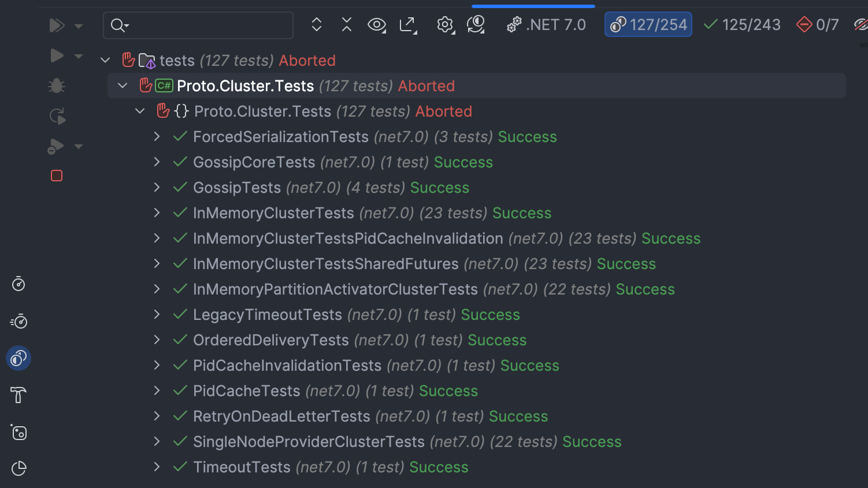

Slide 80
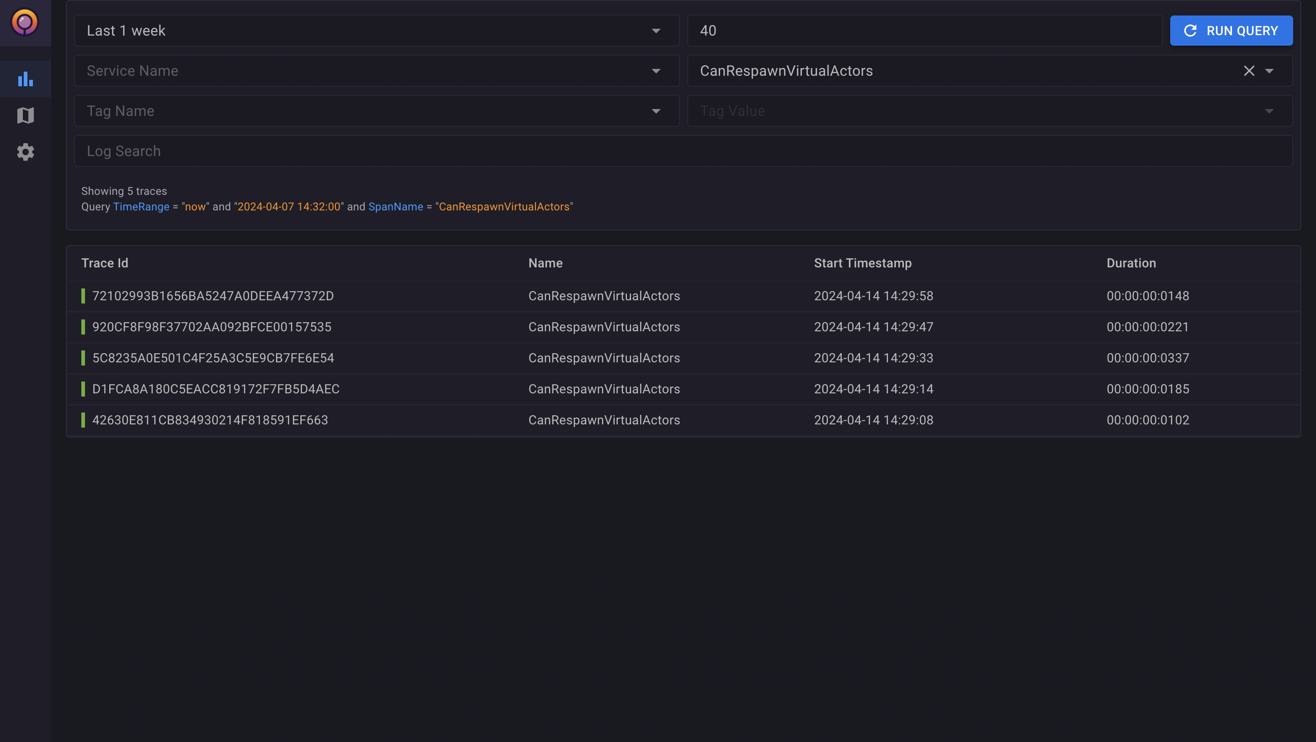

Slide 81
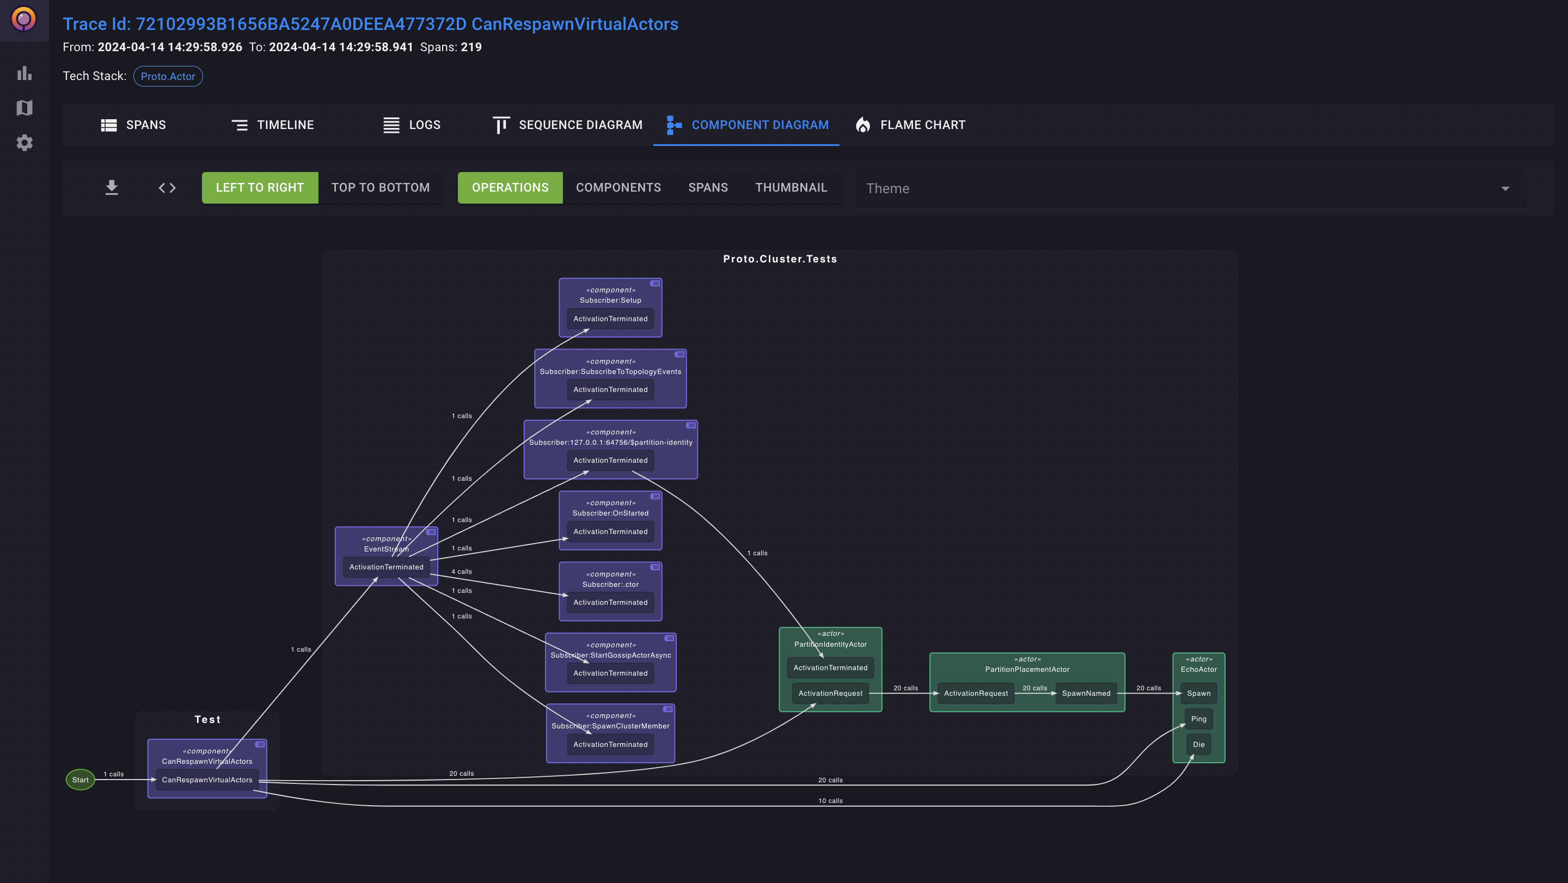

Slide 82
Demo Proto.Actor.OpenTelemetry

Slide 83
Adoption
Make sure it ”works”
e.g.
That all your services are instrumented.
That your observability tool is always up.
That all your teams understand the benefit and how to use the tools.
If any of these parts fail, people will not use it.
They will gravitate back to just reading logs.

Slide 84
Time for questions!

